Slide 1

National Heavy Vehicle Regulator
Les Bruzsa
PBS Scheme Administrator
International PBS Conference March 2013

Slide 2
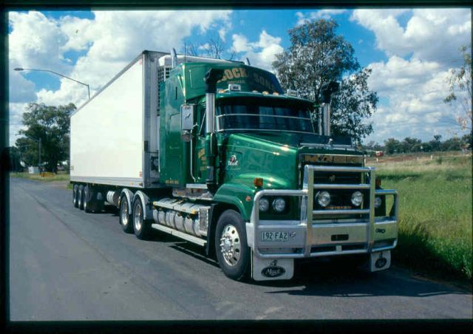
Background
NHVR part of package of COAG reforms to create seamless national economy – single regulators for heavy vehicles, rail and maritime
Focus of NHVR to improve safety, productivity, efficiency of Australia’s heavy vehicle industry
NHVR benefit to Australia’s economy – up to $12.4 Billion over 20 years
Total benefit to Australian economy of all reforms - up to $30 Billion over 20 years

Slide 3
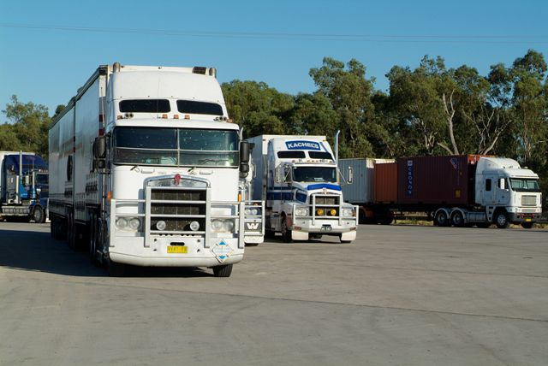

Overview
Bill 1 of Heavy Vehicle National Law passed by QLD Parliament August 2012
Bill 2 introduced to QLD Parliament late 2012 and passed by QLD Parliament in February 2013
Application laws expected be passed by other jurisdictions by mid 2013
Regulator commenced national operations in 21 January 2013.
National Office in Brisbane with NHVR support staff located in jurisdictions to support transition to the NHVR.

Slide 4
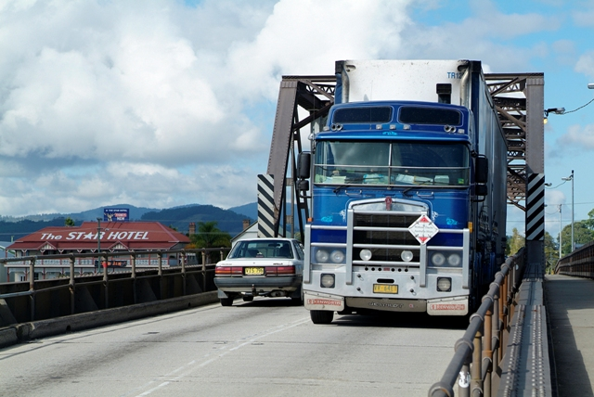
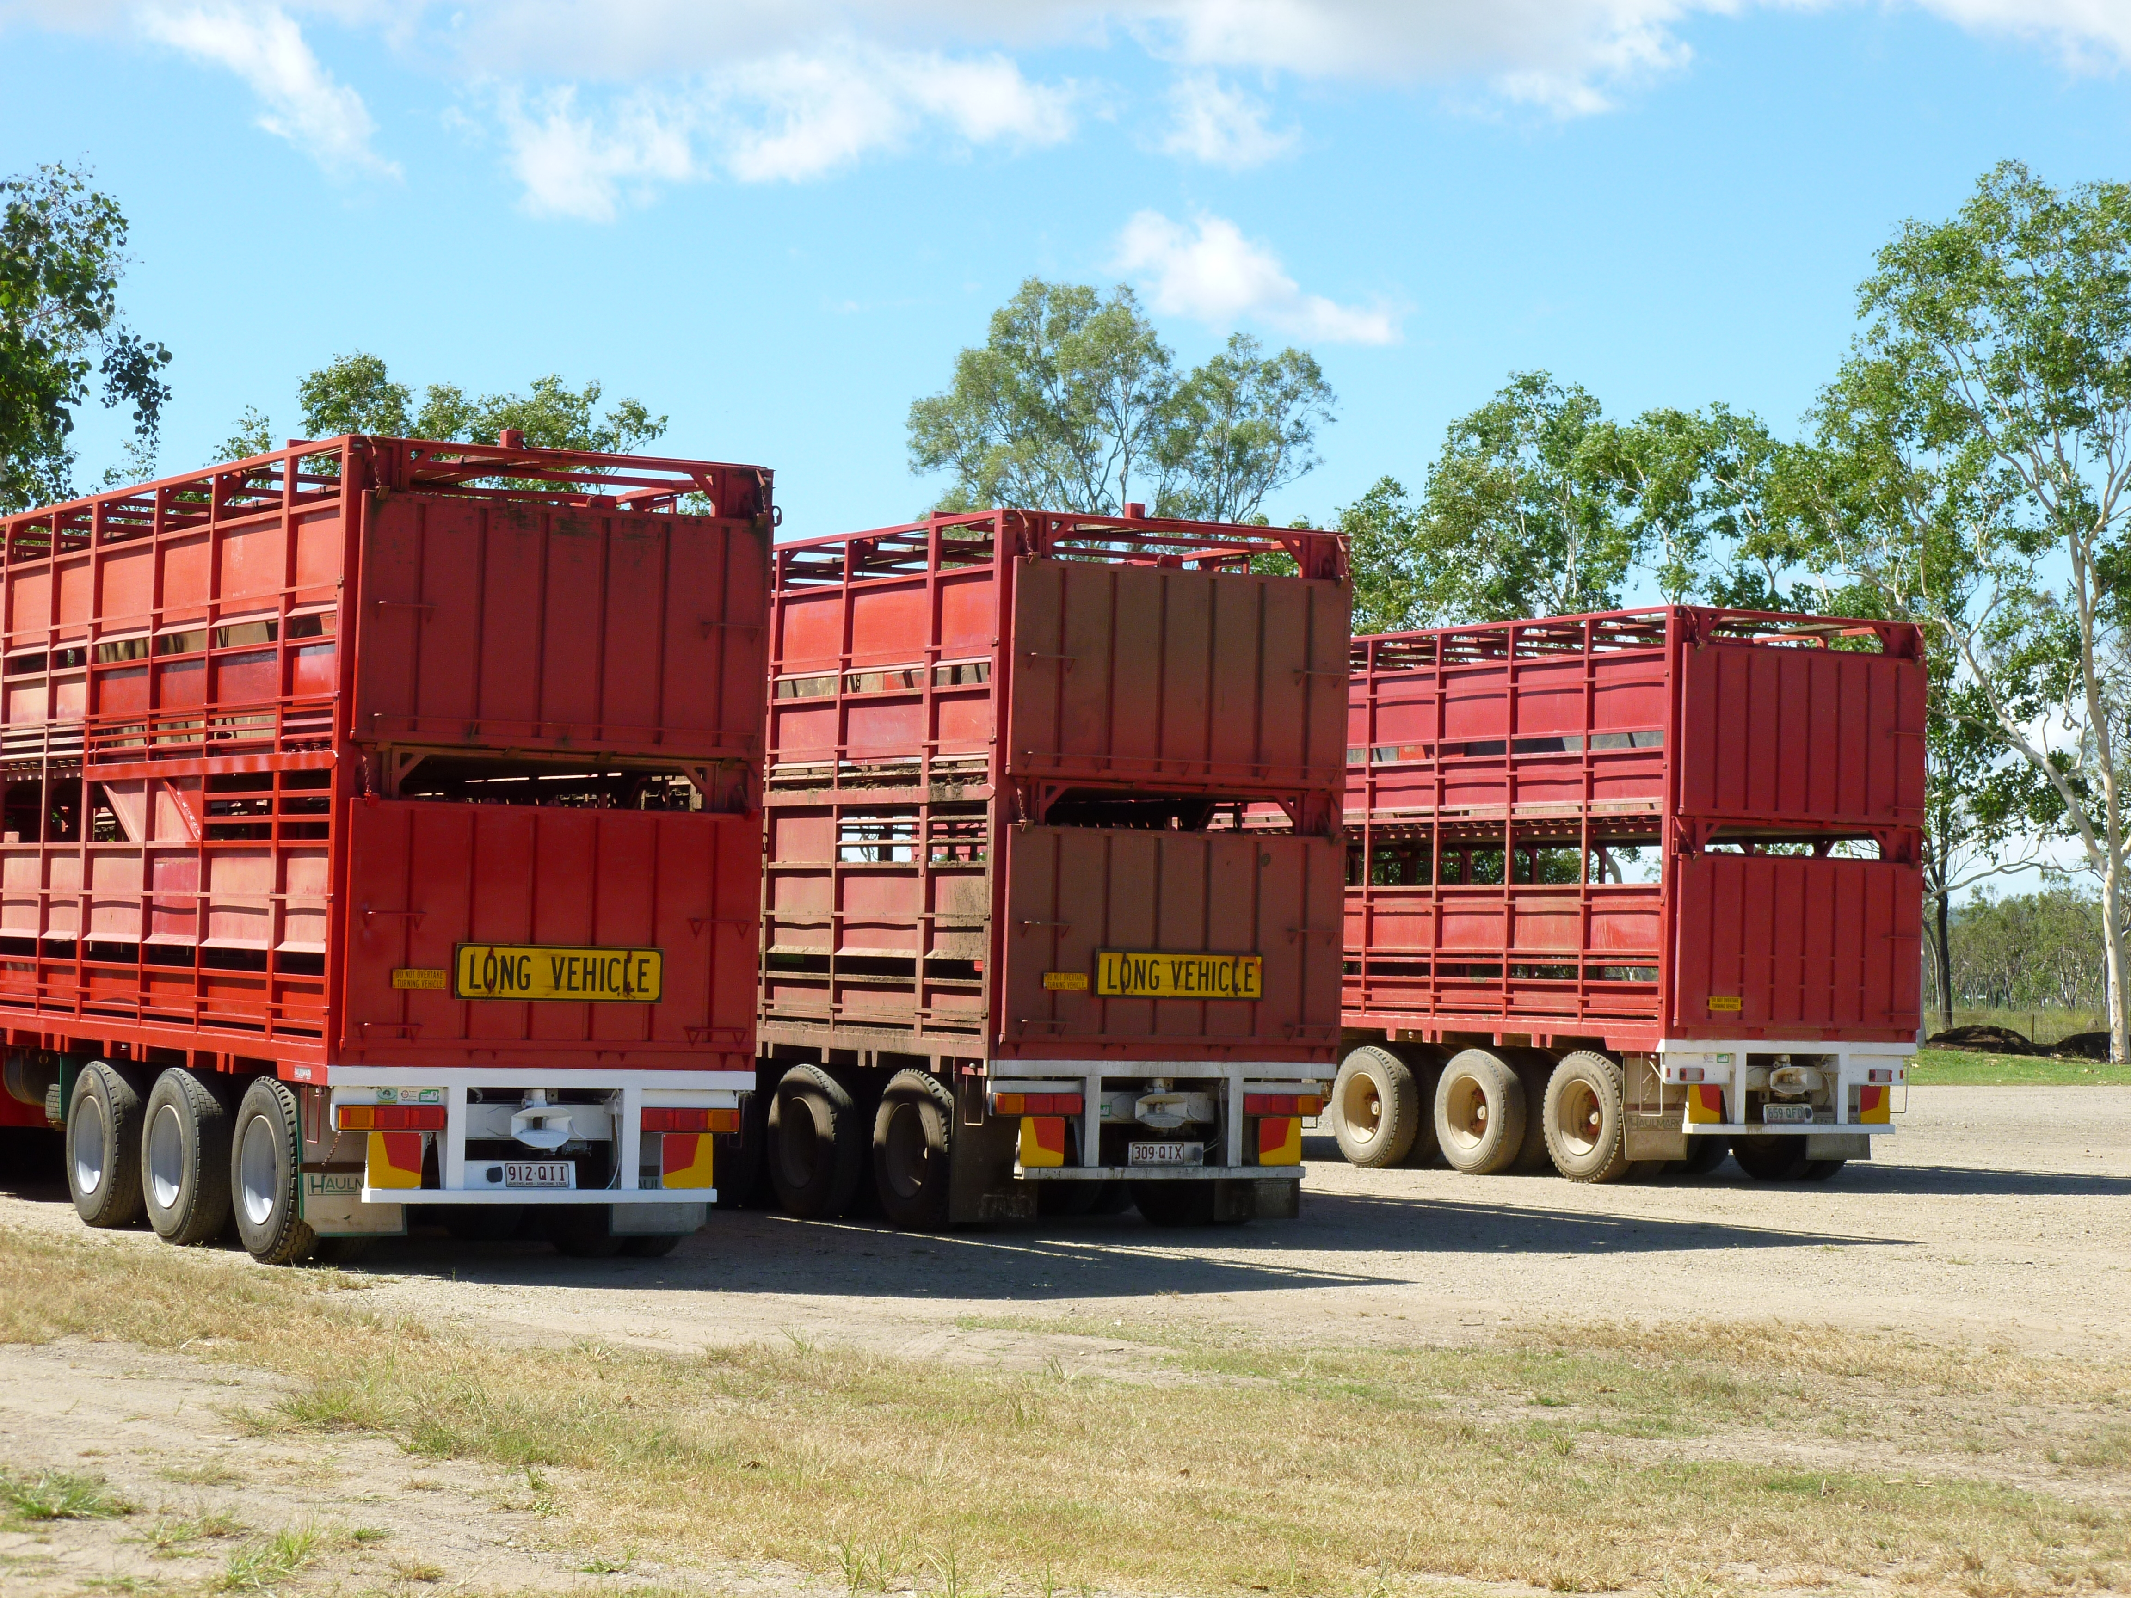
January 2013
Improving Efficiency of Doing Business
One Stop Shop website to receive and process all applications for PBS and NHVAS Accreditation Modules with consistent forms and processes.
NHVR staff providing support to applicants preparing PBS applications, working through PBS approval process and assisting PBS approved vehicles gaining access to the road network.

Slide 5
PBS Statistics

Slide 6
PBS Statistics Cont.
Vehicles Approved:
1115 Rigid Trucks or Prime Movers or Buses
1048 Dog Trailer or Lead Trailer
200 Dolly or Mid/Tag/Rear Trailer
2363 (total) individual vehicle units
Final Approvals / month:
2009 – 5.0
2010 – 14.2
2011 – 18.0
2012 – 33.0
2012 last 6 months – 39.0

Slide 7
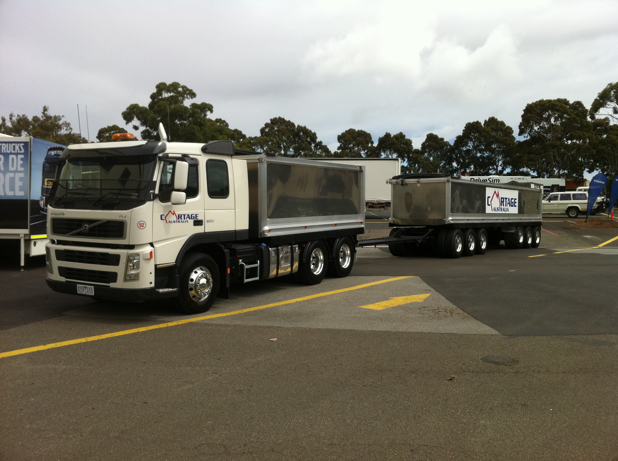
PBS Truck and Dogs

Slide 8
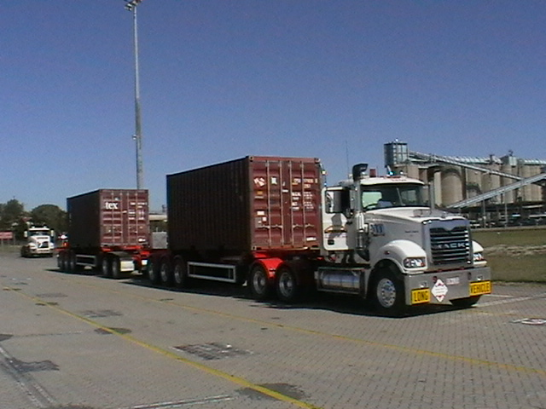
PBS Level 2B Combinations in Qld

Slide 9
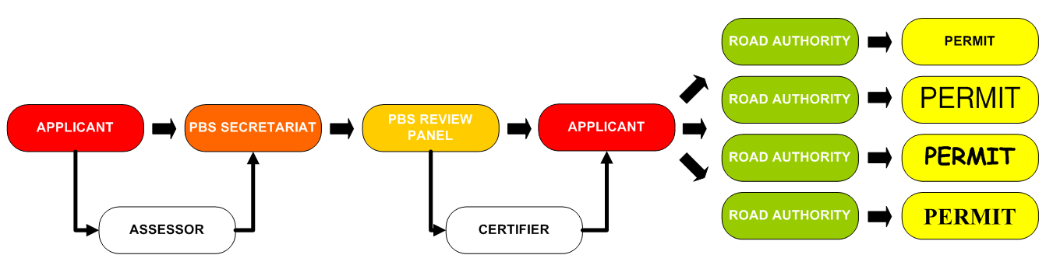

Today (R1)
Administrative arrangement

Slide 10
Mid 2013
Improving Heavy Vehicle Access
National on‐line permit application and mapping system (phone and fax also available) incorporating:
  Real time information on application status.
  NHVR issuing all approved permits and rejections.
  NHVR issuing statements of reasons for access rejections.
  Route maps displaying all nationally gazetted routes.
  Details of access arrangements and requirements.

Slide 11
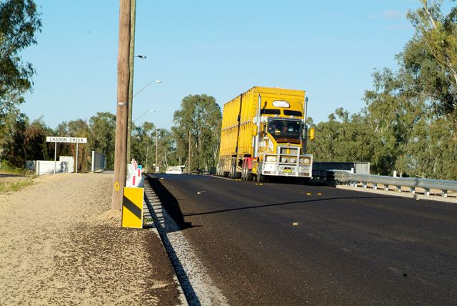
Mid 2013
Improving Heavy Vehicle Access (continued)
NHVR Case Managers assisting applicants throughout the permit process.
Implementation of new internal review processes for access decisions.
Standard Fees and Charges for user pays services provided by the NHVR under the HVNL.
Ministerial Guidelines and other national guidelines available to assist industry with the preparation of access applications and decision making.

Slide 12
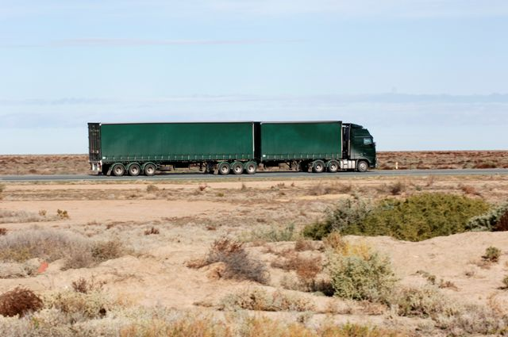
What is NHVR doing to help local government?
Retention of principle that road owner still says who goes on their roads and under what conditions
Retention of principle of internal review only of decisions – not external tribunal e.g. VCAT
Develop on-line route assessment tool in partnership with local government
Access management guidelines to ensure councils get full information from applicants
Case managers to liaise between applicant and road owner
Technical support

Slide 13
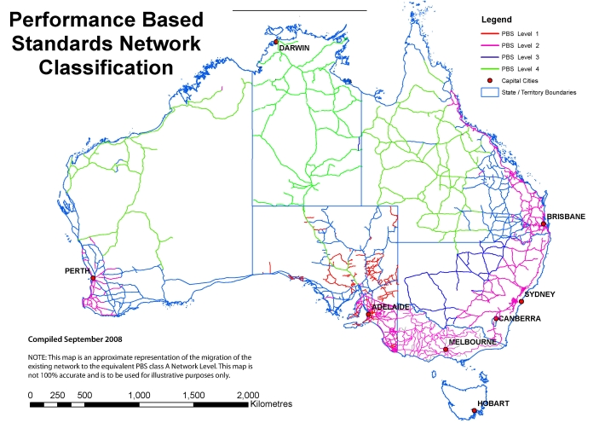
Future (R2)
Assessed design and access request
National Heavy
Vehicle Regulator
National PBS maps
PBS
applicant
PBS Review Panel
Design approval
Apply operating conditions
Vehicle approved to run under national Class 2 notice or Class 3 permit issued
Additional access arrangement and conditions agreed with road managers
Confirmed PBS access added to maps
Road managers (incl. local governments)
RM₁
RM₂
RM₃
RM₄
RM₅
RM_{n}

Slide 14
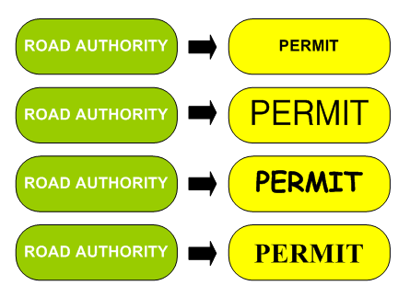
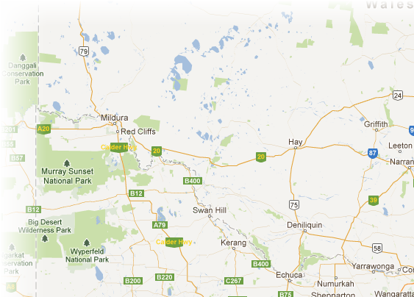

Future (R2)

Slide 15
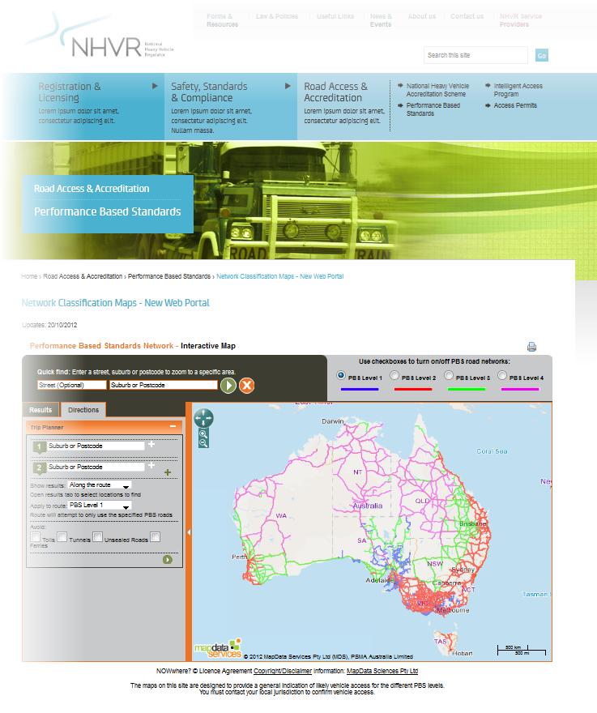
Future (R2)

Slide 16
Some of the PBS Tasks of NHVR
Improving the approval process
  Simplify the process
  Modular certification
Reviewing (enhancing) the PBS standards
  Which standards are relevant?
  How to address technological developments?
Improving access
  Consistency of access decisions

Slide 17

Post July 2013
Legislative Forward Work Program up to 2014.
Operations Forward Work Program up to 2017.
  Access
  Compliance and Enforcement
  Vehicle Standards
  Registration
Review of National Penalties (court imposed maximum penalties and infringements) to be completed in 2014.
These are all inputs to the Strategic Plan and Business Plan of NHVR.

Slide 18
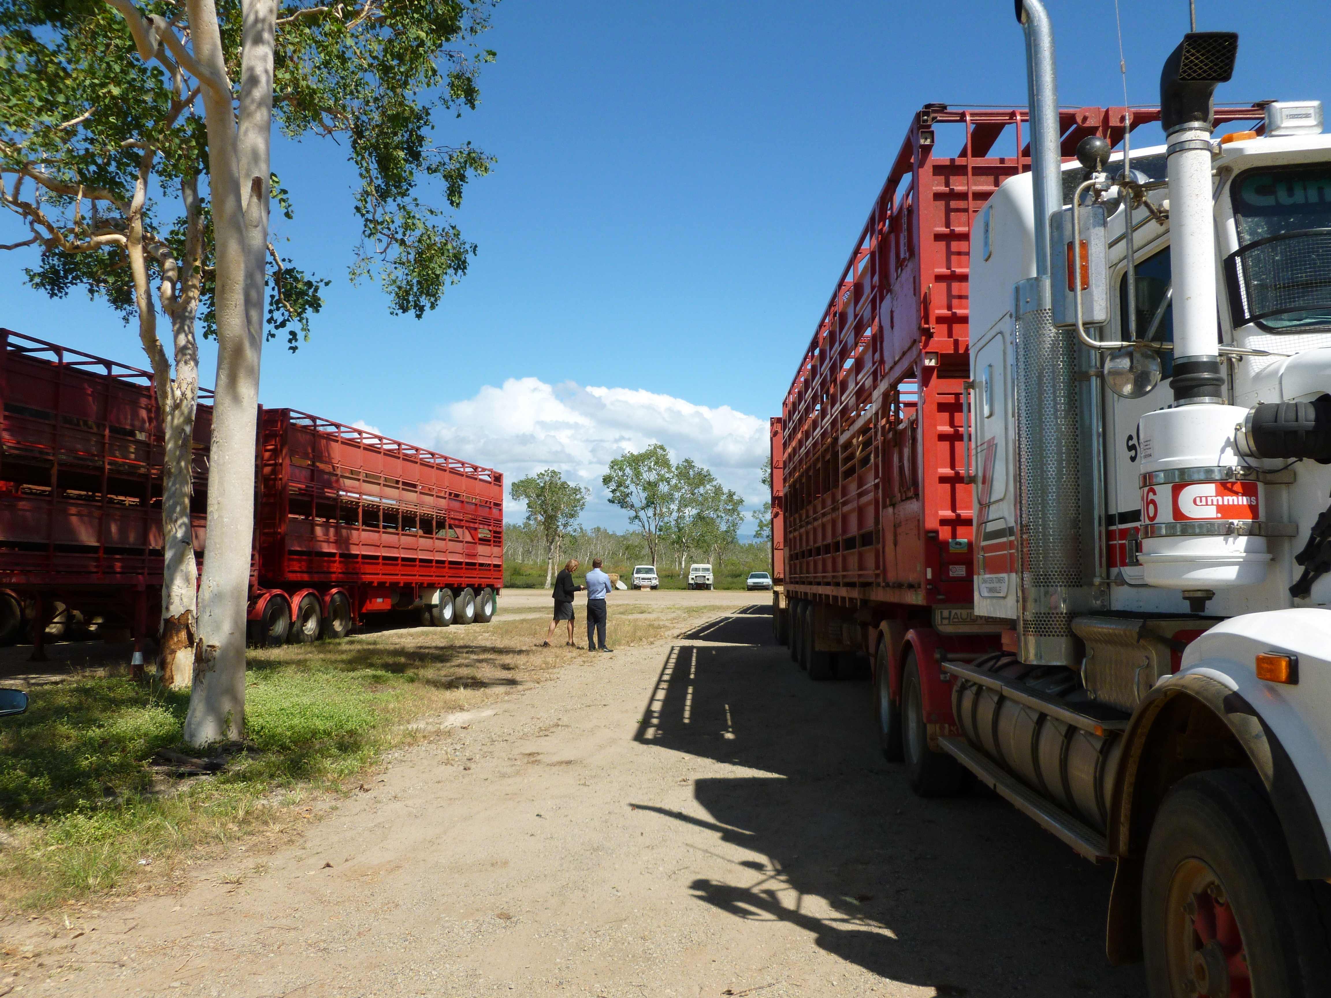
More Information
‘Road to Regulator’ newsletter – via website subscription
NHVR Project Office contact details
Subscribe: form on contact page www.nhvr.gov.au
Website: feedback/enquiry option www.nhvr.gov.au
Email: info@nhvr.gov.au

