Slide 1
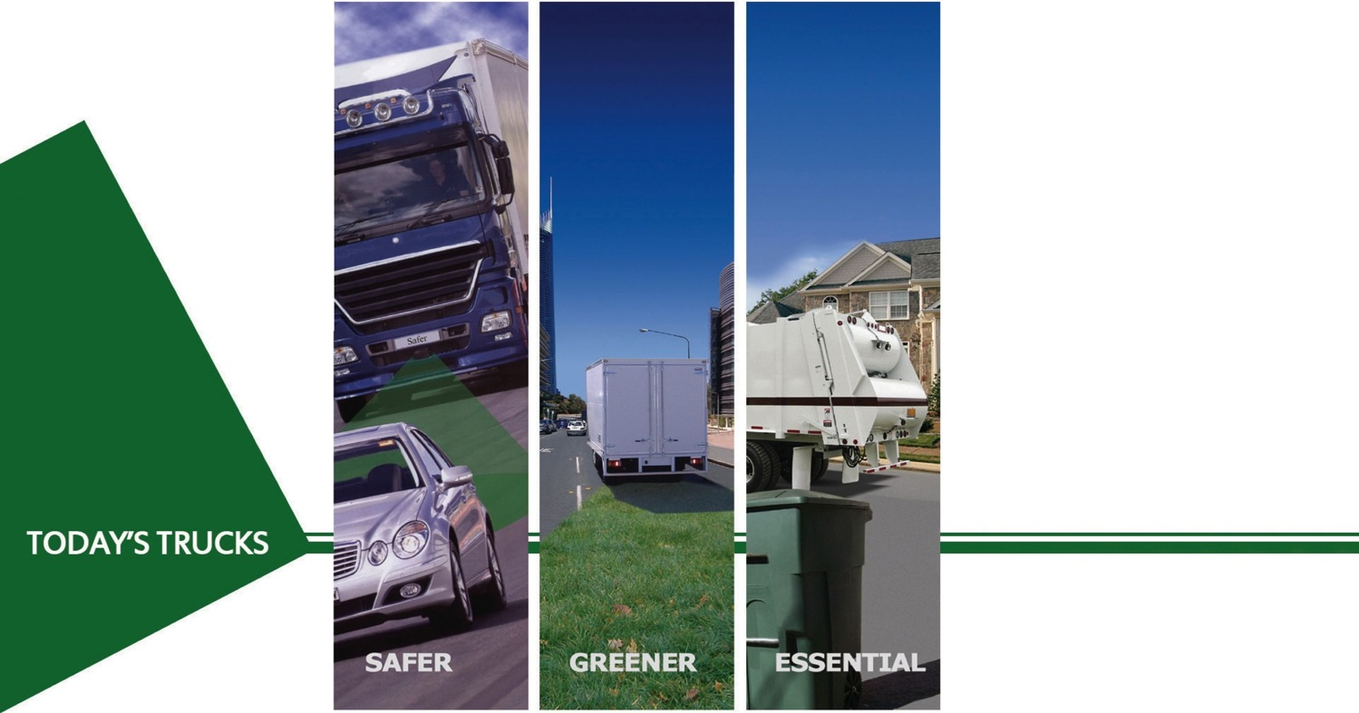

Today’s Safer Trucks
Simon Humphries, Chief Technical Officer

Slide 2
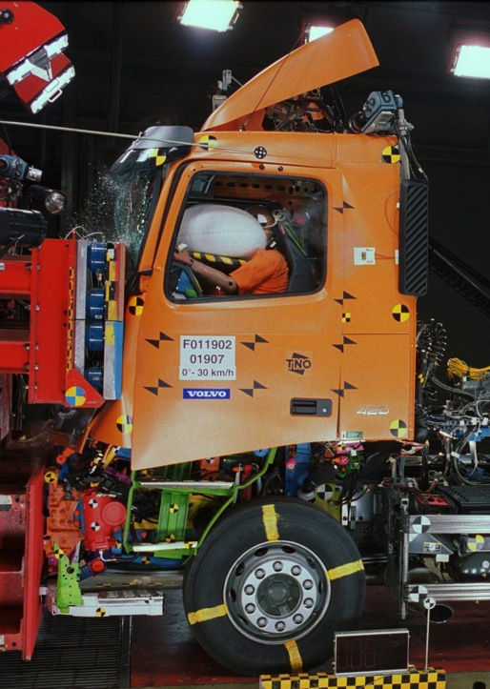
Contents
Who is TIC?
Background Statistics
Older trucks are not safer trucks
The future
The problem: how to modernise the fleet?
Conclusion
Sponsor Panel Q&A

Slide 3
Who is TIC?
Truck Industry Council formed 2001
Represents heavy vehicle manufacturers
  Policy
  Technical
Promotes new trucks as:
“Safer, Greener, Essential”
12 full members, → 17 truck brands
3 associate members (engine & component suppliers)

Slide 4










Truck brands represented

Slide 5
Background Statistics
Australian truck fleet is too old
At 31 March 2010:
      Slightly higher than 2009 average
      Only marginally lower than 2005 average of 14.4 years
Other developed countries: ~ 8 years
Truck Type | Average Age (years)
Light Rigid: | 10.9
Heavy Rigid: | 15.4
Articulated: | 10.9
All trucks registered: | 13.7
Source: ABS 9309.0 Motor Vehicle Census Released 1 Feb 2011

Slide 6
Growth to meet the task
Total trucks registered:
  in 2005: 458,205
  In 2010: 536,247 units = 17% more, or 3.3% p.a.
BITRE Road Freight Task forecast 2008-2030:
  up by 80% overall*
    Year-on-year growth of 2.7% p.a.
  up by 170% for interstate movements*
    Interstate task year-on-year growth of 4.7%
Sources: ABS 9309.0 Motor Vehicle Census Released 1 Feb 2011 and
*BITRE Road Freight Estimates Research report # 121, Sep 2010

Slide 7
Trucks are getting larger…
Trend towards larger capacity trucks.
In past 5 years, articulated trucks with >60 T GCM increased by 49.3%, to > 40,000 units in 2010
In 2010, more than half of all articulated trucks
have > 60T GCM
In past 5 years, Rigid trucks > 20 T GVM:
  Up by 30%, to > 83,000 units in 2010
  rigid trucks < 20T up by only 14%
Sources: ABS 9309.0 Motor Vehicle Census Released 1 Feb 2011 and
*BITRE Road Freight Estimates Research report # 121, Sep 2010

Slide 8
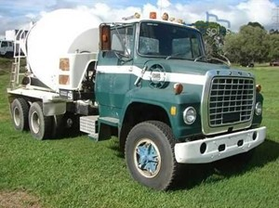
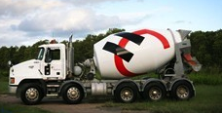
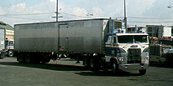
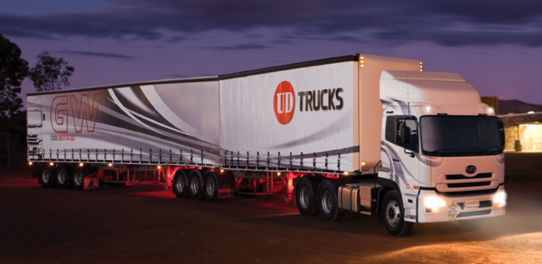
Growth in size
Yesterday
Today

Slide 9
Yet, crash stats show…
Source: BITRE Fatal heavy vehicle crashes Australia, released Jul 2010

Slide 10
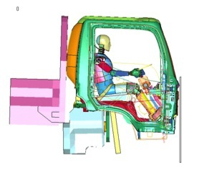
Is this enough?
The trend is in the right direction…but…
We still have 200 fatal crashes per year involving heavy rigid and articulated trucks
  200 crashes that could be avoided with:
    Safer trucks,
    Safer operating practices, and
    Safer infrastructure
  We all need to play our part

Slide 11
Year of Manufacture
Number of trucks first registered pre-1995:
1995 & earlier trucks:
  no emissions compliance (ADR 70 started 1995/6)
  Few modern safety features
Truck Type | Pre-1995 models | % of total fleet
Light Rigid | 32,280 | 28%
Heavy Rigid | 144,494 | 46%
Articulated | 21,440 | 26%
Non-Freight | 8,642 | 38%
All trucks registered | 206,856 | 39%
Source: ABS 9309.0 Motor Vehicle Census Released 1 Feb 2011

Slide 12
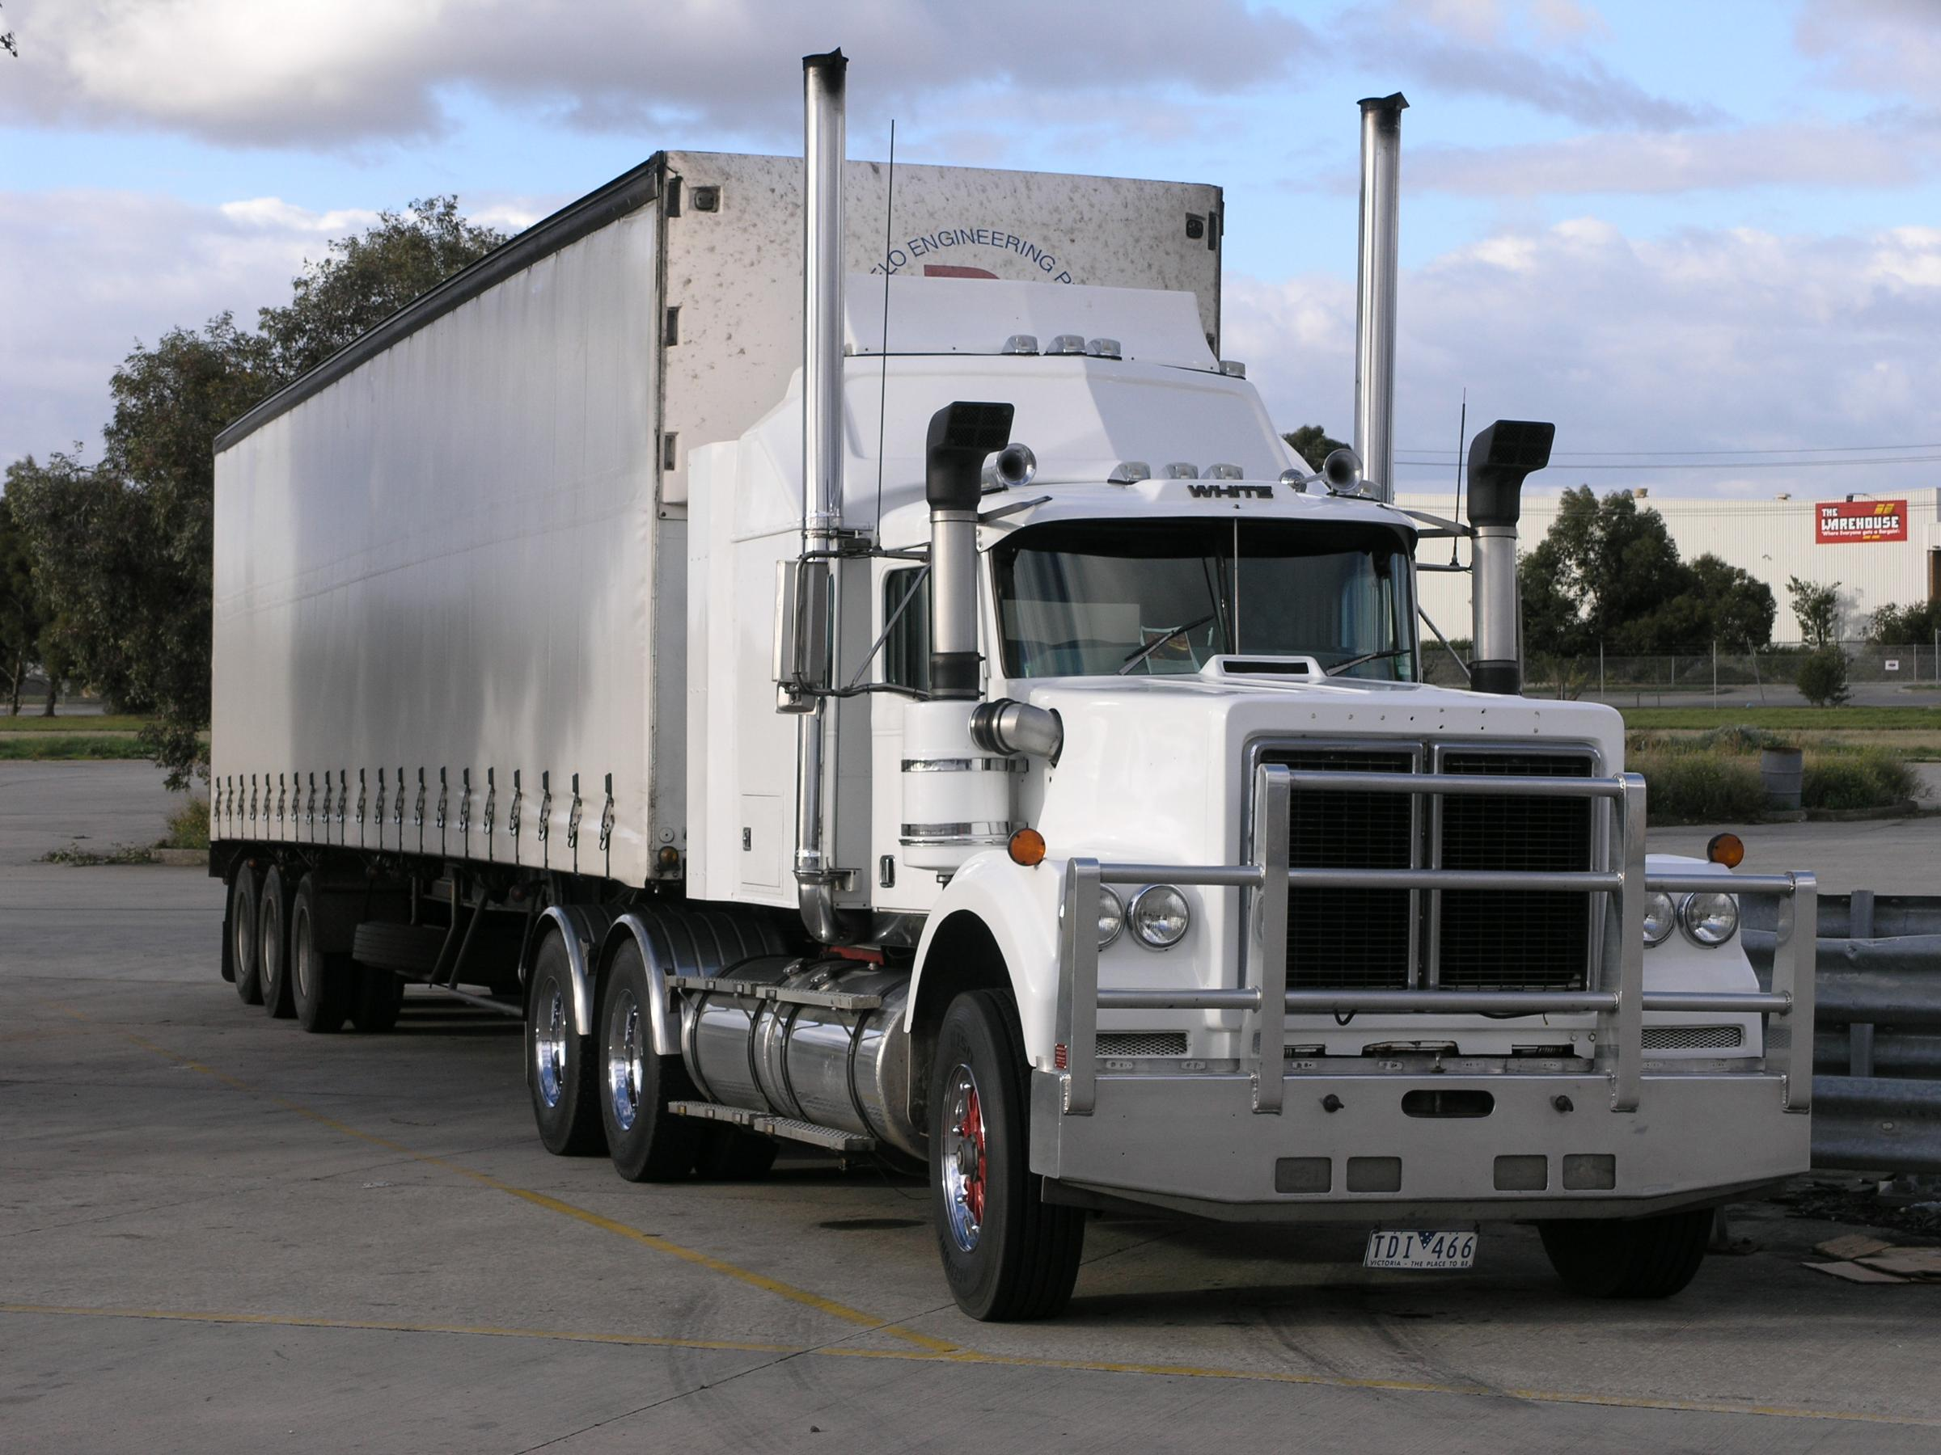
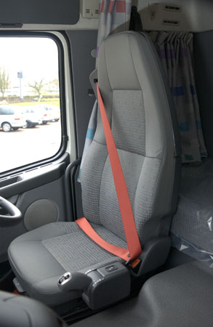
Older trucks are not safer trucks
No ABS
No FUPS Devices
Poor Ergonomics
Increased noise levels
No Automated transmissions
Most don’t have lap-sash seat belts
Older trucks not always maintained well
  Increased smoke → illnesses & poor visibility

Slide 13
The Future
Today’s trucks are safer than ever
Advanced features on new trucks
  Examples on show today
These features will NOT be available to retrofit on older trucks
These features are often expensive
$$$

Slide 14
Example 1: Radar Detection
Detection range and its shape can be optimized by yaw-rate and steering angle.
Unoptimized radar range
Road sign
Yaw-rate
Steering angle
The expanded detection range for earlier
system activation Timing
Optimized radar Detection Range
Source: Hino Trucks

Slide 15
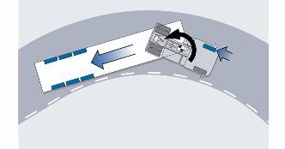
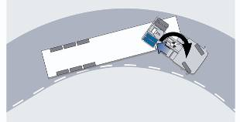
Example 2: ESP / ESC
Understeer ESP provides:
roll over protection
advanced ABS control to retain directional stability
In an understeer situation, an individual drive axle brake is applied to straighten the combination.
Oversteer In this situation the offside front brake and trailer brakes are applied.
Brake correction for oversteer
Brake correction for understeer
Source: Volvo Trucks

Slide 16
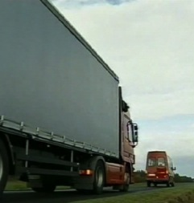
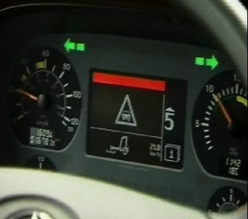
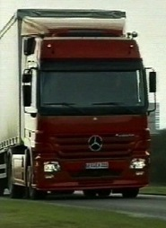
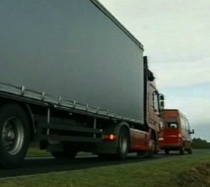
Example 3: Brake Assist
Critical distance
reached
Warning level 1
Warning level 2
Successful
collision prevention
Action
Truck approaches the vehicle ahead
Driver is warned (visually with a red light bar, acoustically through a warning tone)
Partial braking with 30% of max. braking power (Vehicles driving behind are warned via the brake lights)
Maximum of braking power
Source: Mercedes-Benz Trucks

Slide 17
The Problem
We aim for Zero fatalities & Zero crashes
This means:
  Accelerating adoption of safer, greener new trucks
  Accelerating infrastructure improvements
    Roads, ITS communications technologies
  Promoting advanced driver training
The above won’t happen fast enough without government involvement

Slide 18
Modernise the Truck Fleet
Focus on 200,000+ trucks that are > 16 yrs old
Incentives for safer, greener trucks
Reduce the capital cost and/or operating costs of owning a new truck
  Investment allowances
  Incentives for safety packs & features
  Lower registration costs for safer, greener trucks

Slide 19
Conclusion
Statistics show Australian trucks are very old by world standards (14 vs 8 yrs average age)
To cope with growing freight tasks, trend is towards larger capacity trucks
Old trucks are not as safe as new trucks
To move towards goal of zero fatalities, accelerate adoption of newer trucks
Government incentives required

Slide 20
Thank you.
Questions?

Slide 21
Sponsor Panel
Facilitator: Peter Hart
Daimler Trucks: Rod Bartolo & Carlo Beltrame
PACCAR: Brad May
Hino: Alex Stewart
Volvo: Johan Alnqvist
Scania: Ian Butler

