Slide 1

Can Bus
What is the CAN Bus ?
A two wire electronic communication data bus between ‘processors’ – i.e. computer computer controllers
Developed by Robert Bosch Gmbh in 1983
Publically released at the SAE Detroit Conference 1986.
Has 12V and 24V versions.
Notes:
1

Slide 2
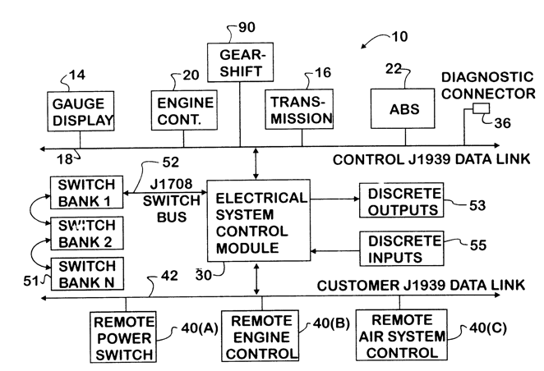
Can Bus
The CAN bus provides hardware and firmware communication protocol for communication between distributed processors without a host.
Notes:
2

Slide 3
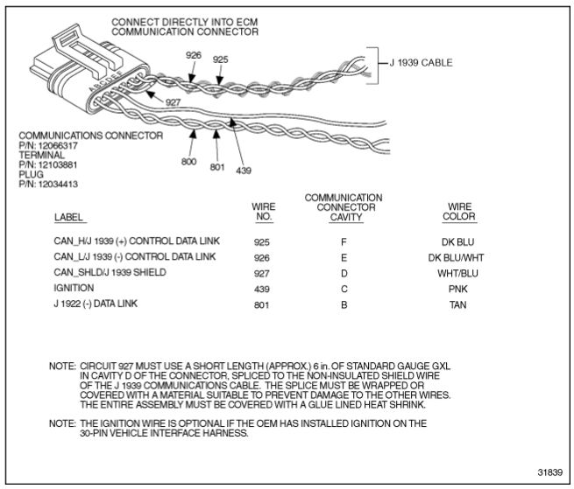
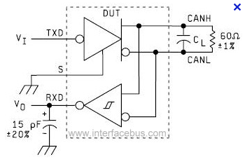
Can Bus – Physical Layer
The usual transmission speed on trucks is is 250 kB/s.
The low speed bus J1708 transmits at 9000 B/s
Notes:
3

Slide 4
Can Bus Data
Data transmissions can be transmitted , received and processed by all processors that are connected to the data bus.
The message header has 21 bits. Eight bytes of data follow.
The message header has a priority level, message type identifiers and error checking bits.
The ECM is ECM is programmed to either regularly broadcast a message or broadcast upon request.
Notes:
4

Slide 5
Can Bus Standards
SAE J1939
ISO 11898-1 CAN 2.0b
These standards have been compatible since year 2000, so a USA CAN bus can talk to a European CAN bus if the voltage level is the same.
Europe mandated a ‘public’ data bus on heavy trucks in 2004 (‘EOBD’).
The USA has mandated a public data bus on light and medium duty vehicles since 1996.
Notes:
5

Slide 6
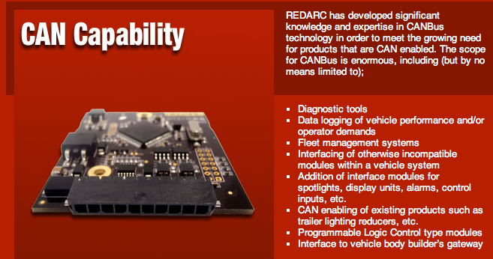
Can Bus Converters
Notes:
6

Slide 7
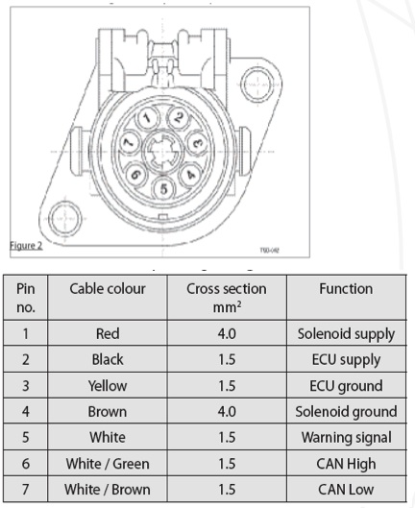
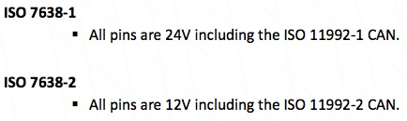
Brake Connectors
Notes:
7

Slide 8
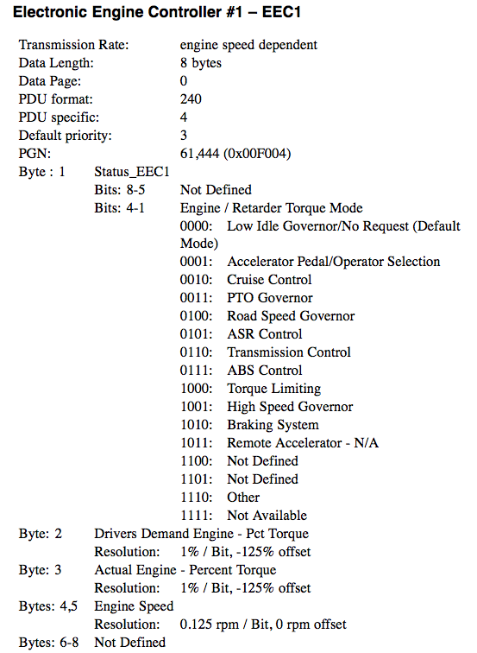
Can Bus Broadcast Data
Notes:
8

Slide 9
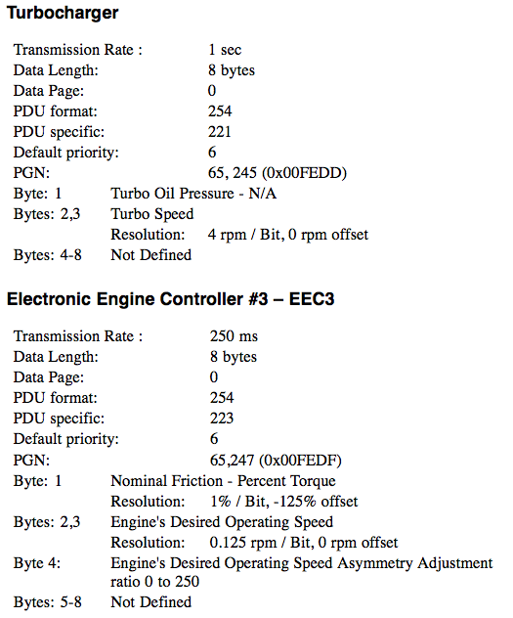
Can Bus Broadcast Data
Notes:
9

Slide 10
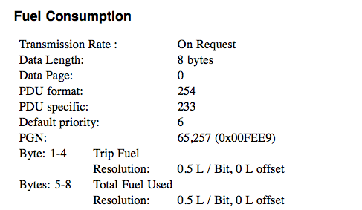
Can Bus Broadcast Data
Notes:
10

Slide 11
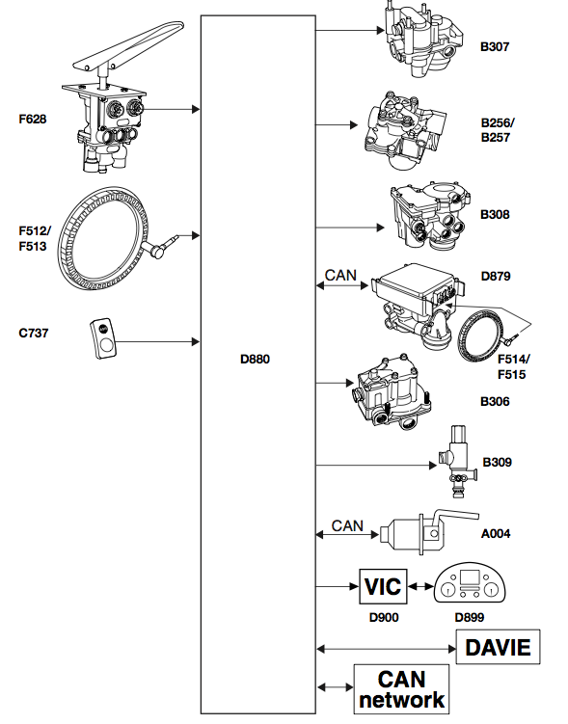
Brake Application
Notes:
11

Slide 12
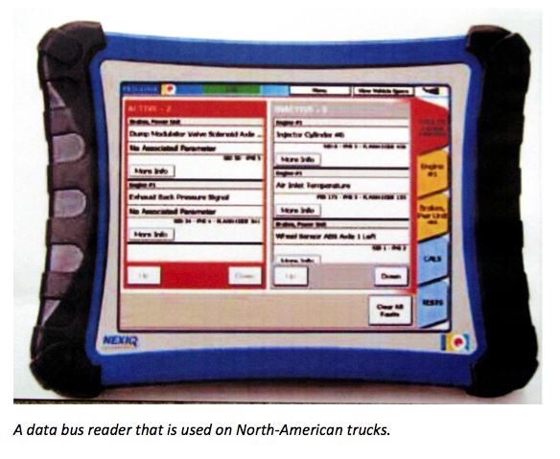
Can Bus Readers
Notes:
12

Slide 13
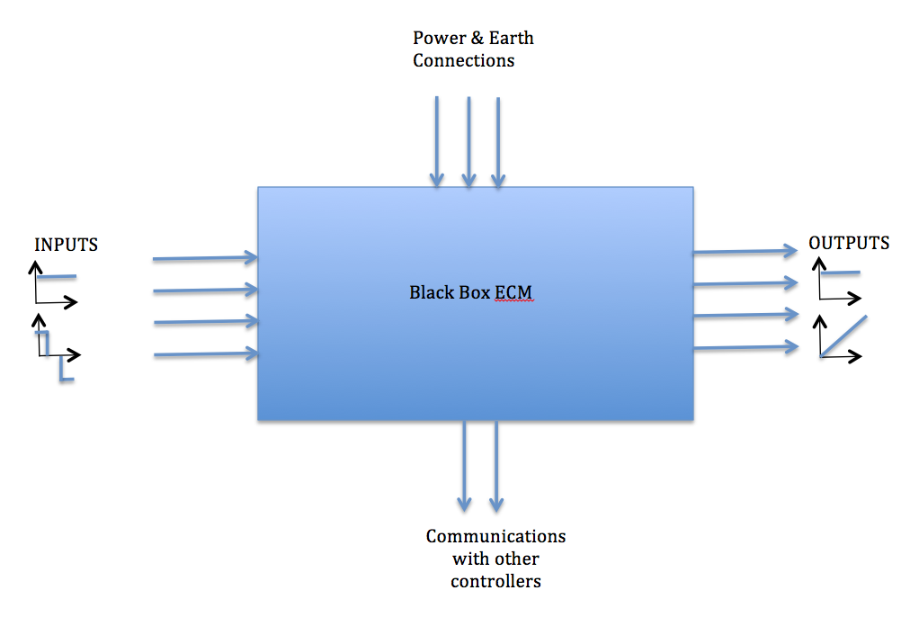
Black Box Approach to Fault Finding
Notes:
13

