Slide 1
Local Government perspective
John Hennessy, MAV

Slide 2
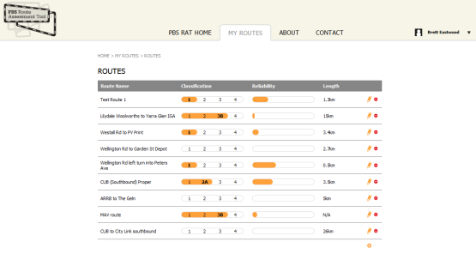
PBS Access for local Roads
1. What is PBS RAT ?
PBS vehicles = fewer trucks, more productivity
#1 impediment for PBS: first-last KM access on local roads
PBS Route Assessment Tool for Victorian Local Govt
ARRB - MAV Project
Development of LG guidelines and Online software tool

Slide 3
How the Tool Helps
Push for HPV access to local roads, National Regulator means a change in responsibilities for LG
Goal is to achieve consistency in route classification (access) by using a tool that is:
  Suitable for local government
  Easy to use, quick or detailed: can get ‘first cut’ in 60 minutes
  Support for both near-zero and rich data inputs
Simplifies PBS guidelines for local road infrastructure
Exists to make life easier and support local managers
Repeatable and traceable workflow and record for access decisions in local area

Slide 4
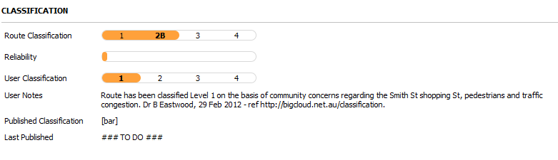

Supplementing Existing Access Processes
Tool supplements, not replaces existing process
PBS RAT provides a practical technical classification
More detailed classification possible using Guidelines
Ultimate decision is still Local Road Manager
System Publishes completed routes to 3rd parties

Slide 5
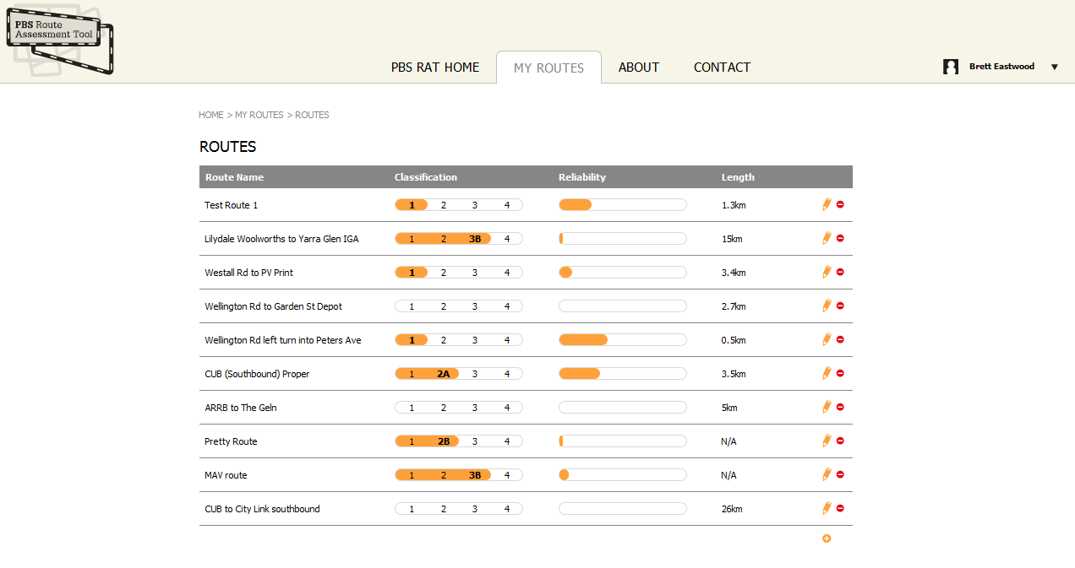
PBS RAT Features
Web-based tool (PBS RAT) - No special software required
System supports, educates and simplifies local government HV access decision making
Provides both classification and indication of classification reliability

Slide 6
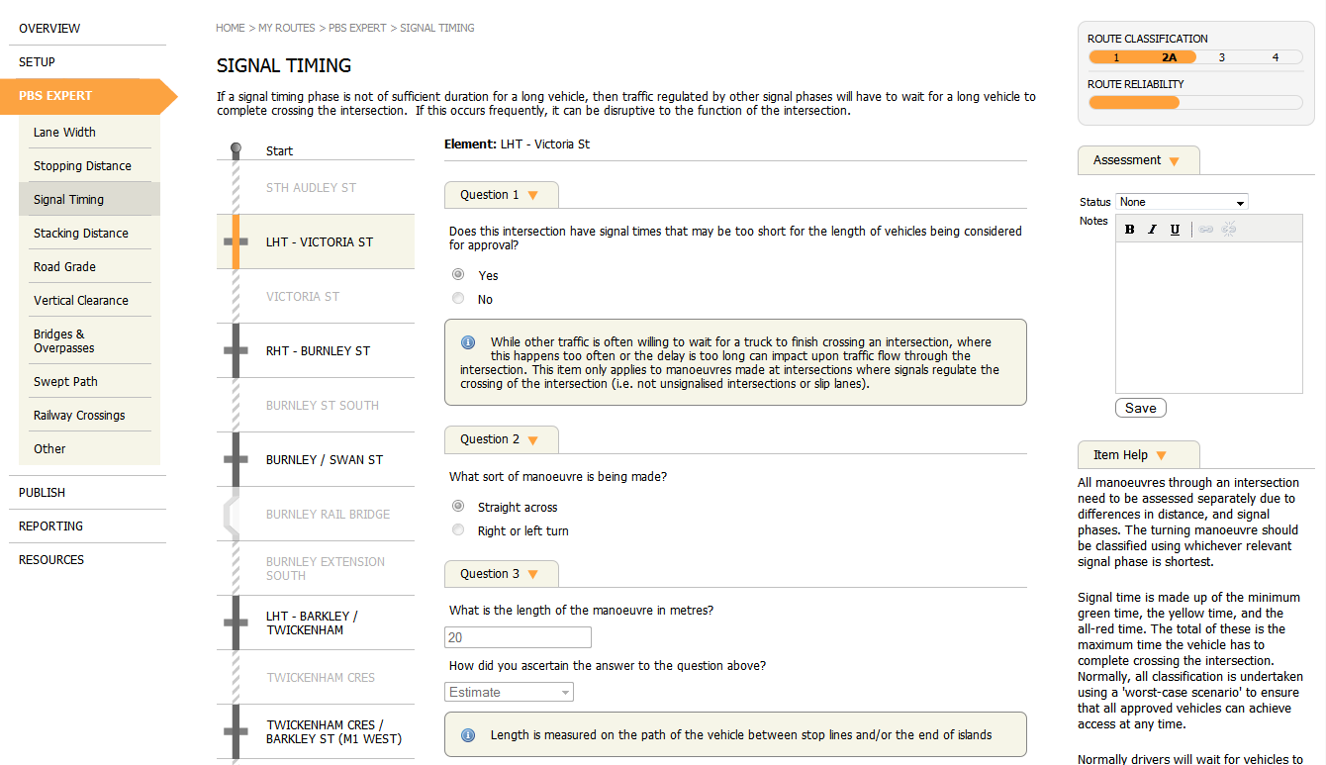
Operation Overview

Slide 7
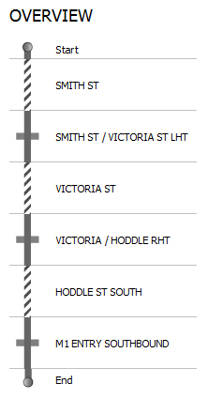
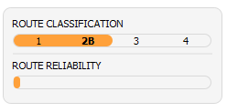
Pinch Points
Assumes highest level of access, but lowest reliability
  Considers routes in terms of its restrictive limitations (pinch points)
  Allows for progressive classification of routes with “quick and dirty” followed by adding more detail
Lane Width (2B)
Signal Timing (2A)
Actual route classification (2A) is the lowest access level granted by these restrictive features
Swept Path (3A)
Storage Lane Length (2B)

Slide 8
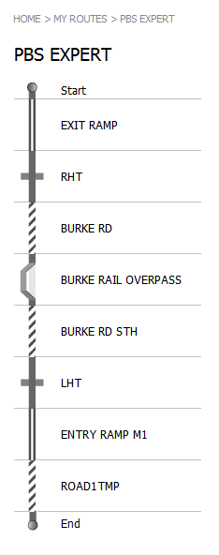
Building routes
You can check how the routes look as a strip map in PBS Expert
Next step: Add a map

Slide 9
System Outputs
PBS Classification Score (PBS level 1-4 a/b)
Detailed classification reports, including pinch point(s)
Flags assessment of bridges & pavement if needed (OOS)
Consolidated “published” route reporting area
Mapping outputs - route and location
Data export linkages through road ID’s etc
Additional linkages to be considered in national context
PBS RAT
SRO’s
NHVR
National Route Maps
Research

Slide 10
Progress and next steps
PBS RAT developed by ARRB in partnership with LG
Funded by Victorian and Federal Government agencies (including PoM)
All Victorian Councils now trained how to use PBS RAT
Some have already classified many B-double routes
NHVR was to start operations January 1, 2013 (2014?)
All other States and Territories now trialling PBS RAT in conjunction with NHVR

Slide 11
2. Local Roads Strategic Freight Routes
Project Methodology
Form Regional Groups with at least one representative from each Council and a representative from VicRoads
Each Council in region to identify their existing approved B-Double routes on Council roads within their own municipality
Regional Group to identify and list Level 2A access roads across the Region
Prepare a combined list of sites where the road network has impediments to achieving Level 2A access
Regional Group to discuss agreed and proposed Level 2A access routes across their Region
Share this information with all Councils in the Region.

Slide 12
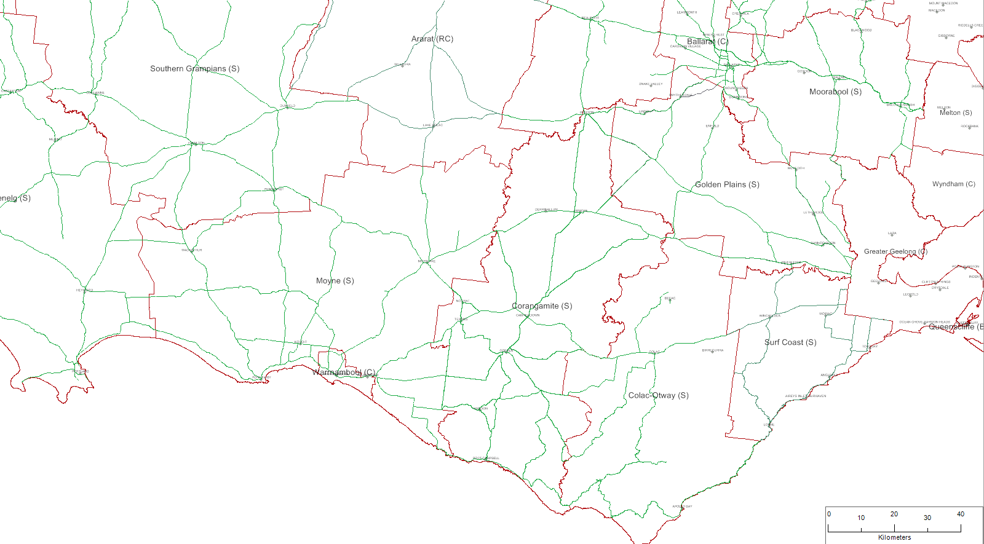
LG – Arterial Roads

Slide 13
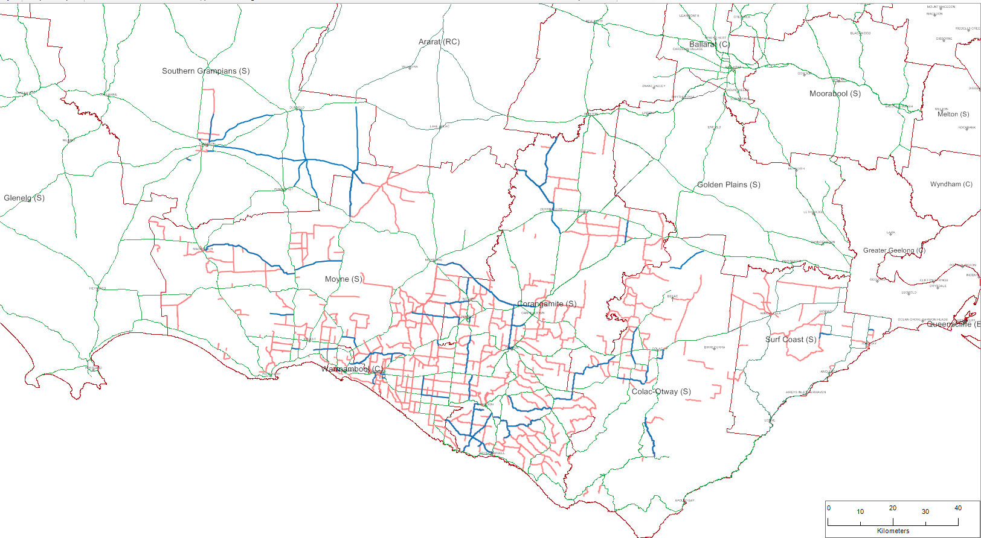
Local Roads – Priority HV Routes

Slide 14
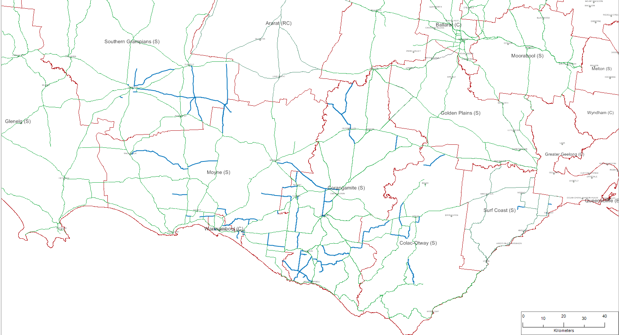
Local Roads – Proposed Level 2A Access

Slide 15
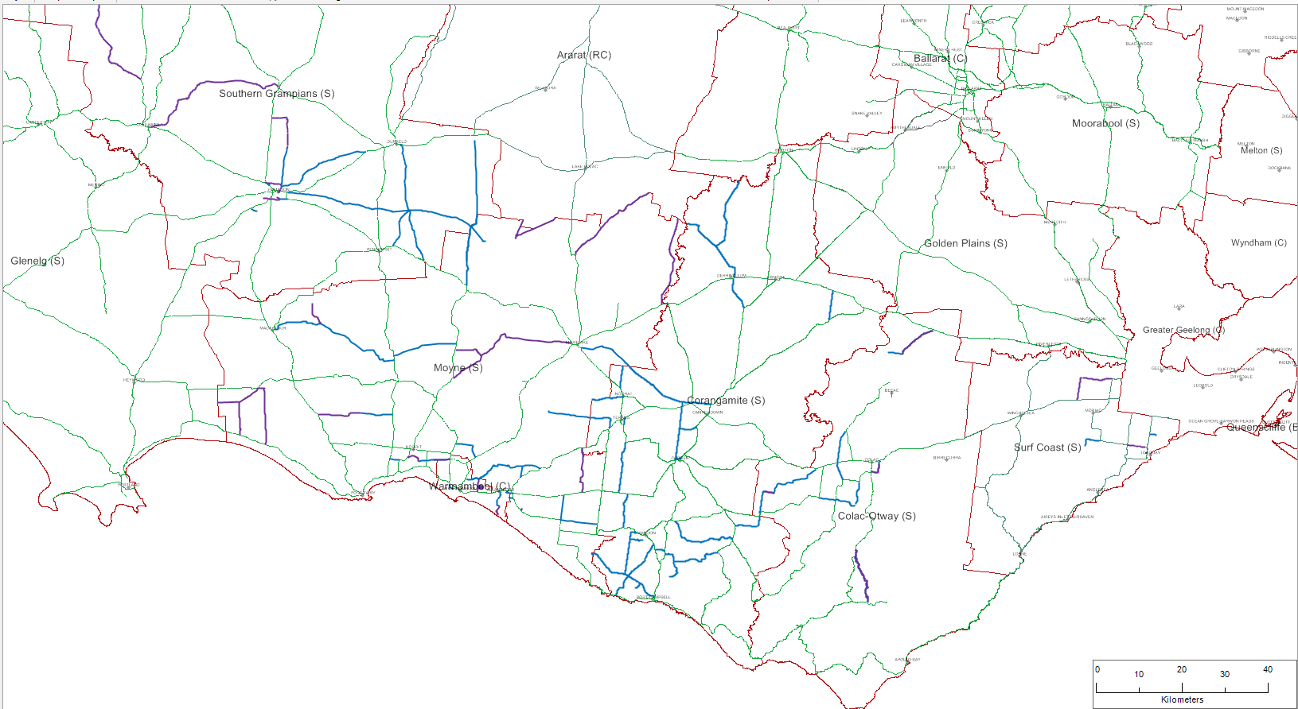
Local Roads – Freight Routes - Upgrades

Slide 16
Corangamite
Road No | Road Name | Length (m) | From | To | Upgrades Required Point Location | Upgrades Required Road Length | Cost of Upgrade | Importance (1 - High, 2, 3 - Low) | Why is this a priority freight route?
 | Proposed Strategic Freight Routes
4620 | BRUMBYS ROAD | 1640 | Curdievale Port Campbell Road | Gas Plant | Nil | Nil | $0 |  | Used for B-Double access to gas plants.
3022 | OLD GEELONG ROAD | 4570 | Darlington Road | Camperdown Lismore Road | Nil | Nil | $0 |  | Alternative for northbound B-Doubles from the west on Princes Highway from travelling through Camperdown township Part of major transport east-west route servicing Warrnambool and South Australia
3002 | CAMPERDOWN DERRINALLUM ROAD | 7930 | Camperdown Lismore Road | Hamilton Highway | Nil | Nil | $0 |  | Part of main route from Camperdown to Derrinallum. B Double route for grain and fodder cartage.
 | Proposed Strategic Freight Routes - Subject to Upgrade
5151 | SANDYS LANE |  | Princes Highway | Castle Carey Road |  | Existing Unsealed Pavement upgrade to seal Pavement | 2,000,000 | 2 | B-Double route for cartage of grain, fodder and stock Supply route to 2 no. feed mills in Cobden Part of link from Hamilton Highway to southern end of Corangamite Shire
3419 | TIMBOON PETERBOROUGH ROAD |  | Timboon Port Campbell Road | Great Ocean Road |  | Widening of 5.0 km of road | 1,000,000 | 2 | B-Double route for milk cartage
3026 | VITE VITE SKIPTON ROAD |  | Vite Vite Road | Shire Boundary |  | Widening of 17.7 km of road | 3,500,000 | 2 | B-double route for grain and fodder cartage Link from Glenelg Highway to service the southern part of Corangamite Shire
3027 | VITE VITE ROAD |  | Hamilton Highway | Shire Boundary |  | Widening of 12.3 km of road | 2,500,000 | 2 | B-Double route for grain and fodder cartage

Slide 17

3. MAV Hume Planning for Freight Pilot:
Regional Freight strategy

Slide 18
Tasks
Review of relevant reports and strategies
Capture freight issues from the 12 councils and regional agencies
Document the freight network
Current and future freight task and network capacity
Strategies to address local and cross-municipal freight issues
Create templates and process guidance for local government
Hume Freight Improvements

Slide 19
Gaps & Revisions I
Definition of the Hume region – food bowl out then in
Heavy vehicle volumes on routes, including the Hume Freeway, Midland Highway, Murray Valley Highway require updating.
Update reflecting 2011 Census data is relevant, particularly indications of the growth of new residential areas.
Drought recovery and the improvement in agricultural product volumes requiring freight movements since 2010
Structural changes to manufacturing that have persisted since 2009
Implications of the two-speed economy and how this has impacted the region
Growth area planning has advanced and this will inform freight movement through and within Murrindindi and Mitchell
The impact of bushfires and floods on assets and local economies
Progress on VicRoads management studies conducted in 2004 on the Murray Valley, Goulburn Valley and Midland Highways.

Slide 20
Gaps & Revisions III
Role of Albury and Mangalore airports in freight for the region
Food Bowl branding and linkages for some initiatives
Supply chain requirements for mining in the region
Lack of information about the freight task, including warehousing, cross-docking, packaging, distribution, cool chain management
Need to work through which routes to which sites will articulate with HPV routes.
Land use planning specifically to manage economic growth and associated freight task
Strategies around how to communicate regarding freight to the community
Acknowledgement of the excellence of the region in skilling people for T&L

Slide 21
Gaps & Revisions III
Role of Albury and Mangalore airports in freight for the region
Food Bowl branding and linkages for some initiatives
Supply chain requirements for mining in the region
Lack of information about the freight task, including warehousing, cross-docking, packaging, distribution, cool chain management
Need to work through which routes to which sites will articulate with HPV routes.
Land use planning specifically to manage economic growth and associated freight task
Strategies around how to communicate regarding freight to the community
Acknowledgement of the excellence of the region in skilling people for T&L

Slide 22
Local freight issues II
Lack of engagement with T&L industry
Scope to expand HV facilities at highway service centres
Freight deliveries to commercial precincts – new design templates
Freight not an intrinsic part of planning process
TIRES under-funded
Need for similar model for Livestock, Dairy, Quarries and Water Extraction industries – consideration of SA commodity routes model?
Inclusion of freight requirements in Infrastructure Design Manual
Regional cities planning an opportunity to integrate freight management strategies and design
As of right land uses that are increasing transport activity – effective management solutions and strategic intent
Industry investment in strategic routes – need for a model that works
NHVR guidance and support for local government taking on HV access decisions

Slide 23
Next steps
Mapping the network
Identifying PBS heavy vehicle access
Gathering data on the freight task (generator and carrier surveys)
Investigating strategic responses/options
Expand to include all Victorian regions

Slide 24
Major PBS issues
Ten years of frustration for LG: still no access guidelines
NHVR behind the curve re timing
IA has the National Freight Strategy as #2 national infrastructure priority but only funds $100m+ projects: freight industry reports that first and last kilometre issues are #1 priority.
  Result: the system doesn’t work!

