Slide 1
Airbag Suspension Parameters for PBS
Mario Colosimo

Slide 2
Airbag Suspension Parameters for PBS
1. Roll Stiffness
2. Roll Steer
3. Roll Centre Height

Slide 3
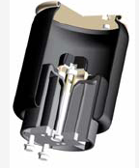
Roll Stiffness
With trailing arm type airbag suspensions, there are two elements to the roll stiffness;
Roll Stiffness due to the airbags
Auxiliary roll stiffness

Slide 4
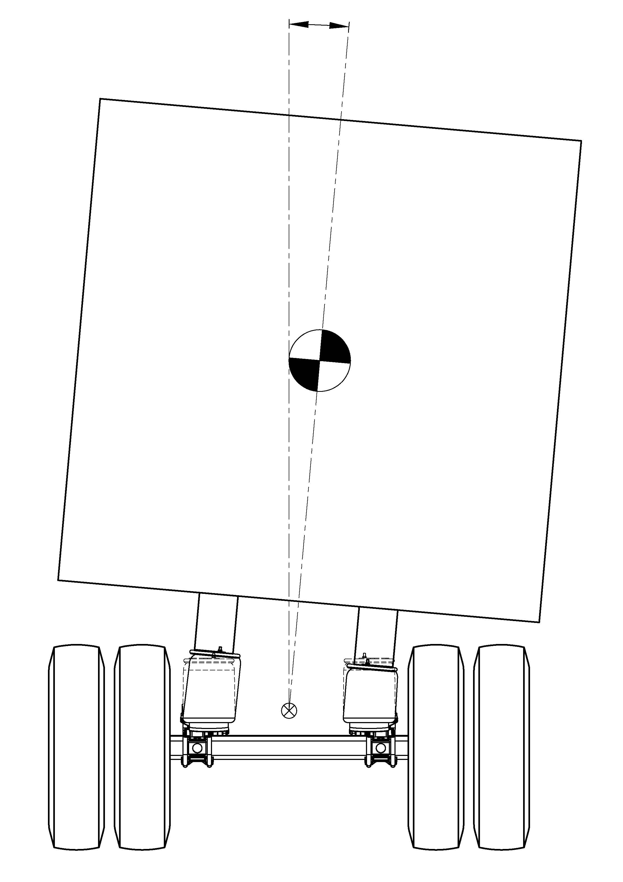
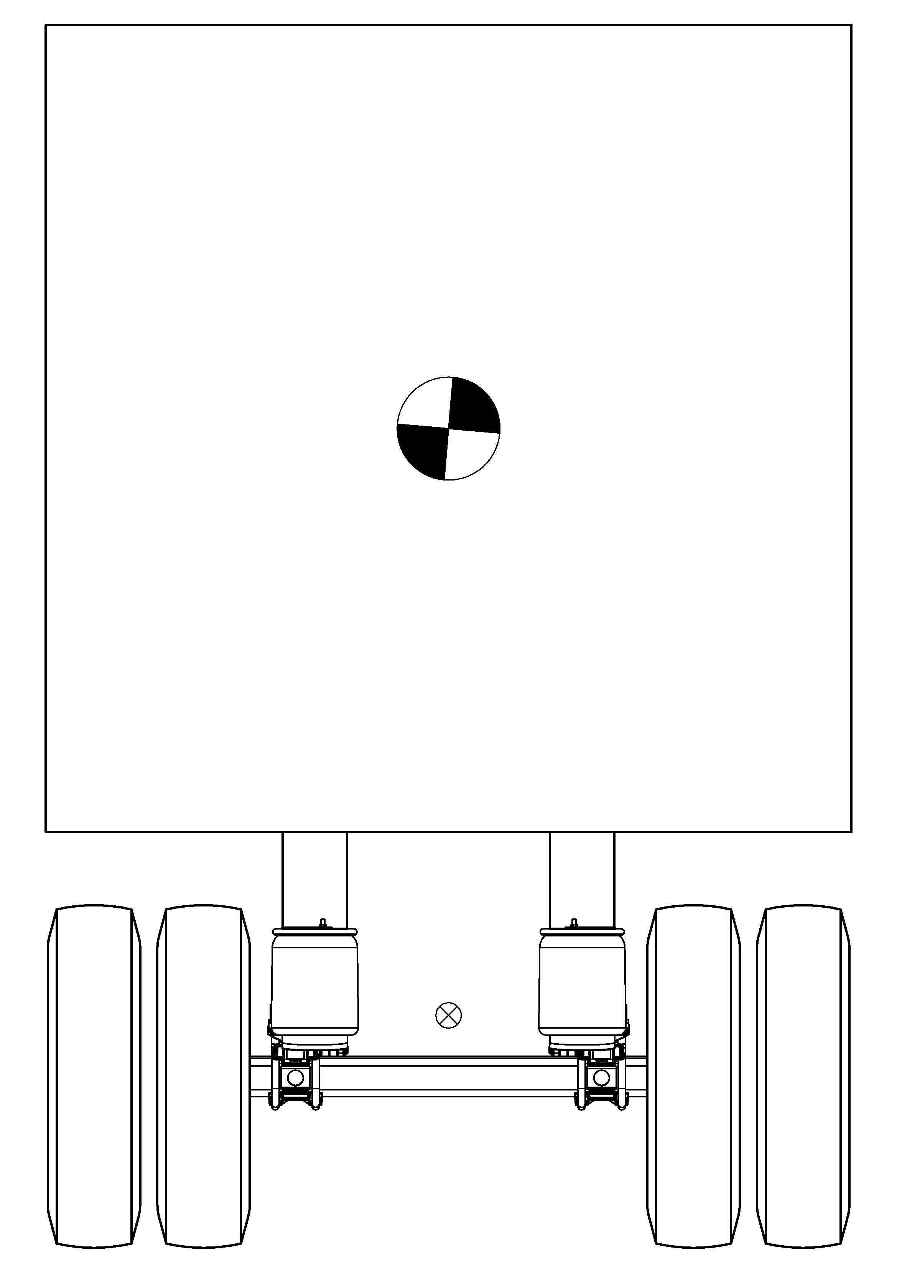
Roll Stiffness due to the Airbags
Roll Angle
With throttled crossflow the airbags contribute approx. 15% of roll stiffness

Slide 5
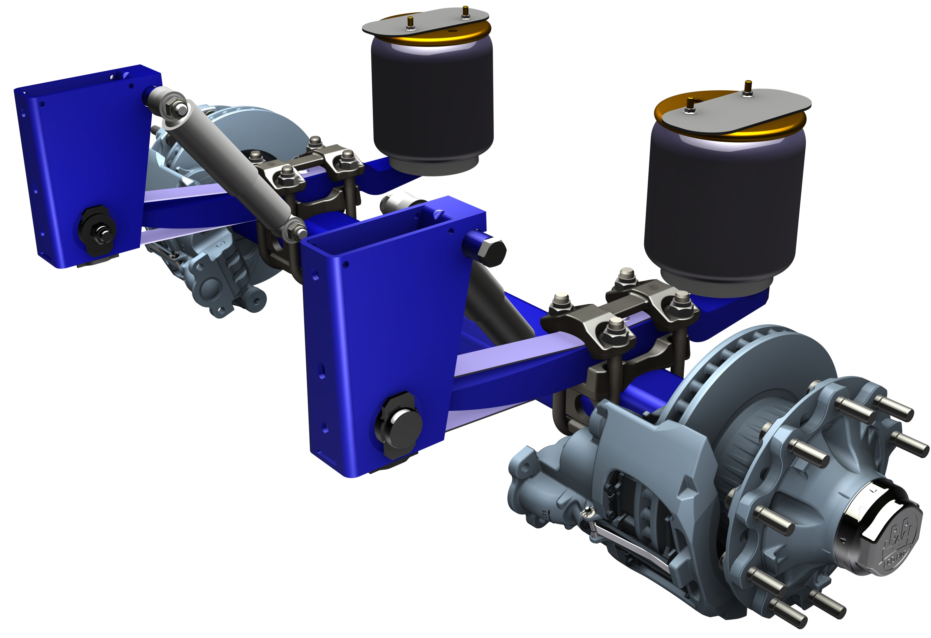
Auxiliary Roll Stiffness
Rigid attachment
Pivot
When the axle rolls about the roll centre, the trailing arm spring bends and the axle beam twists

Slide 6
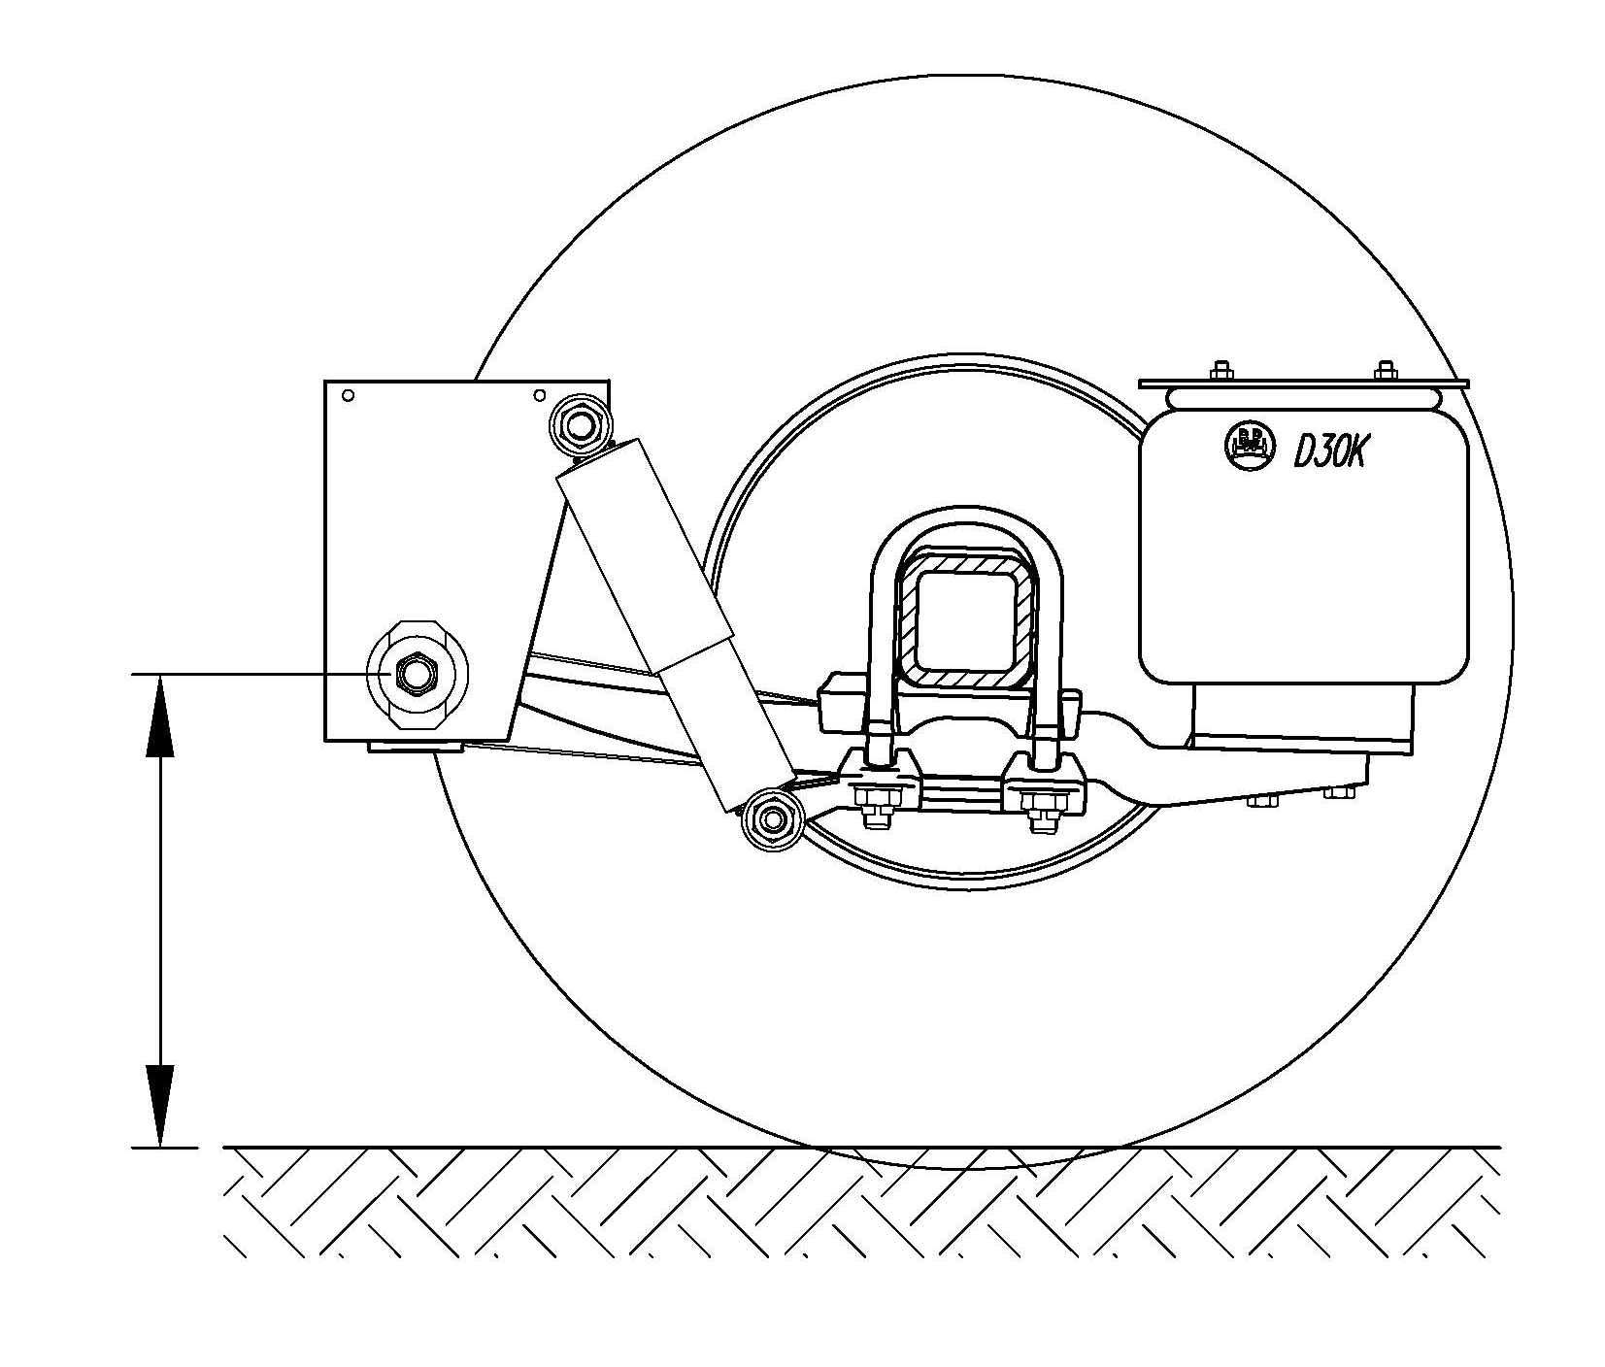
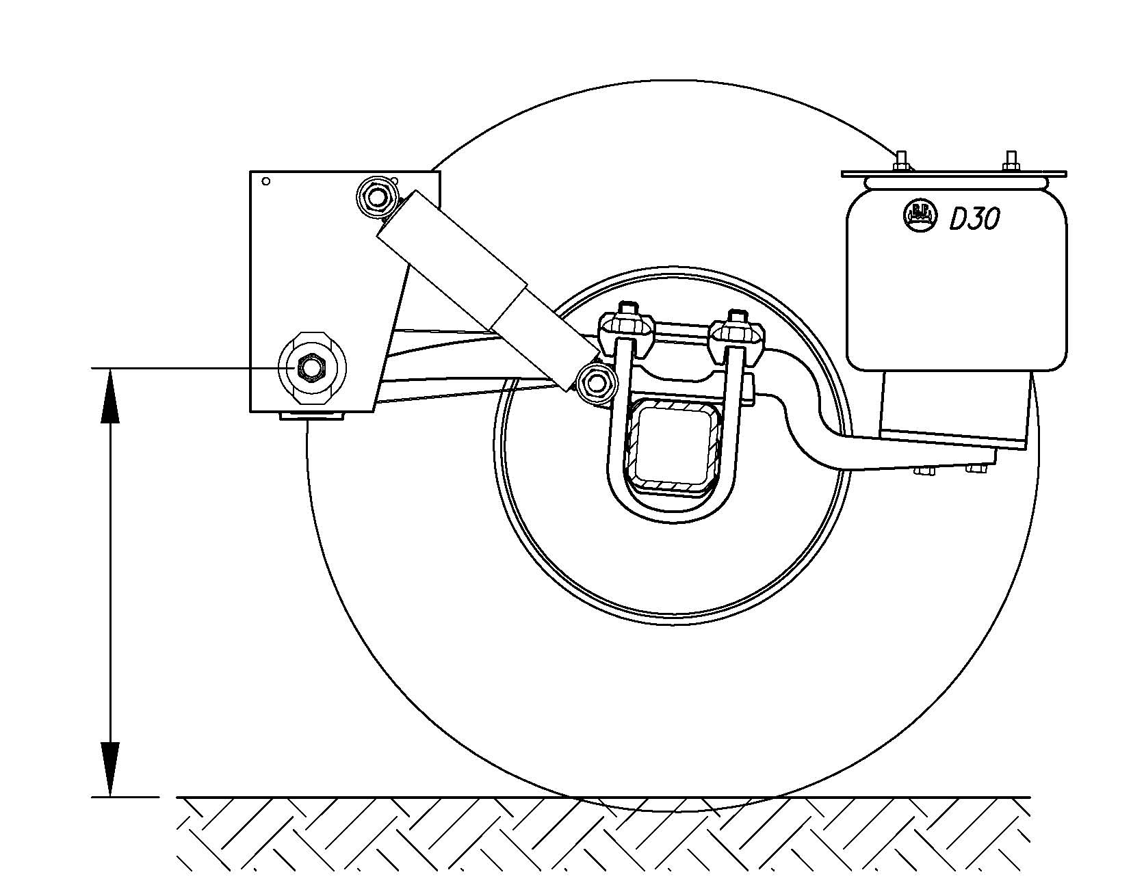
Roll Centre Height
The Roll Centre of the suspension is along the centre of the vehicle, at the height of the suspension pivots

Slide 7
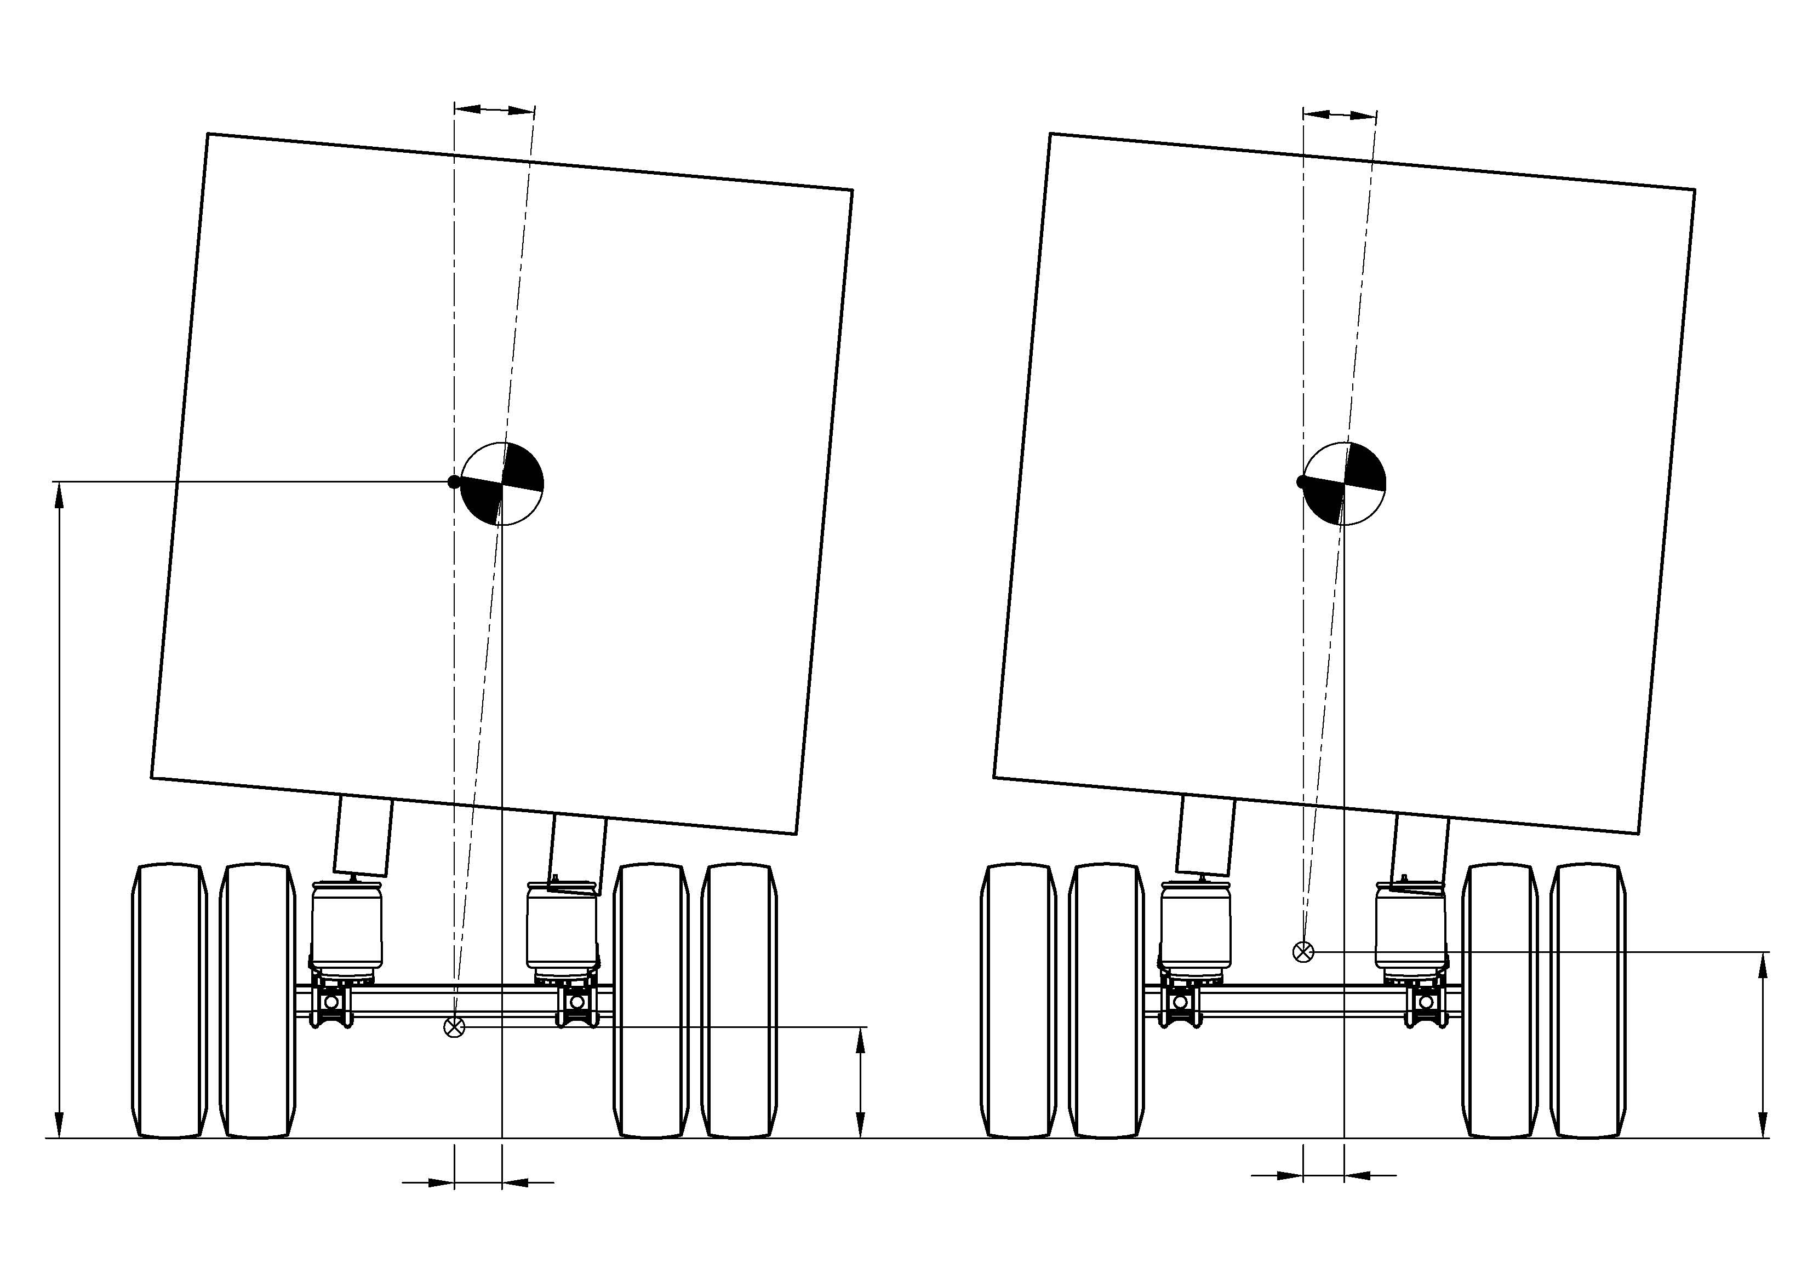
Roll Centre Height
430mm
5°Roll Angle
2540mm
430mm
720mm
184mm
158mm
Example, approx 15% difference in lateral shift of CoG due to different Roll Centre Height – without suspension and tyre deflection

Slide 8
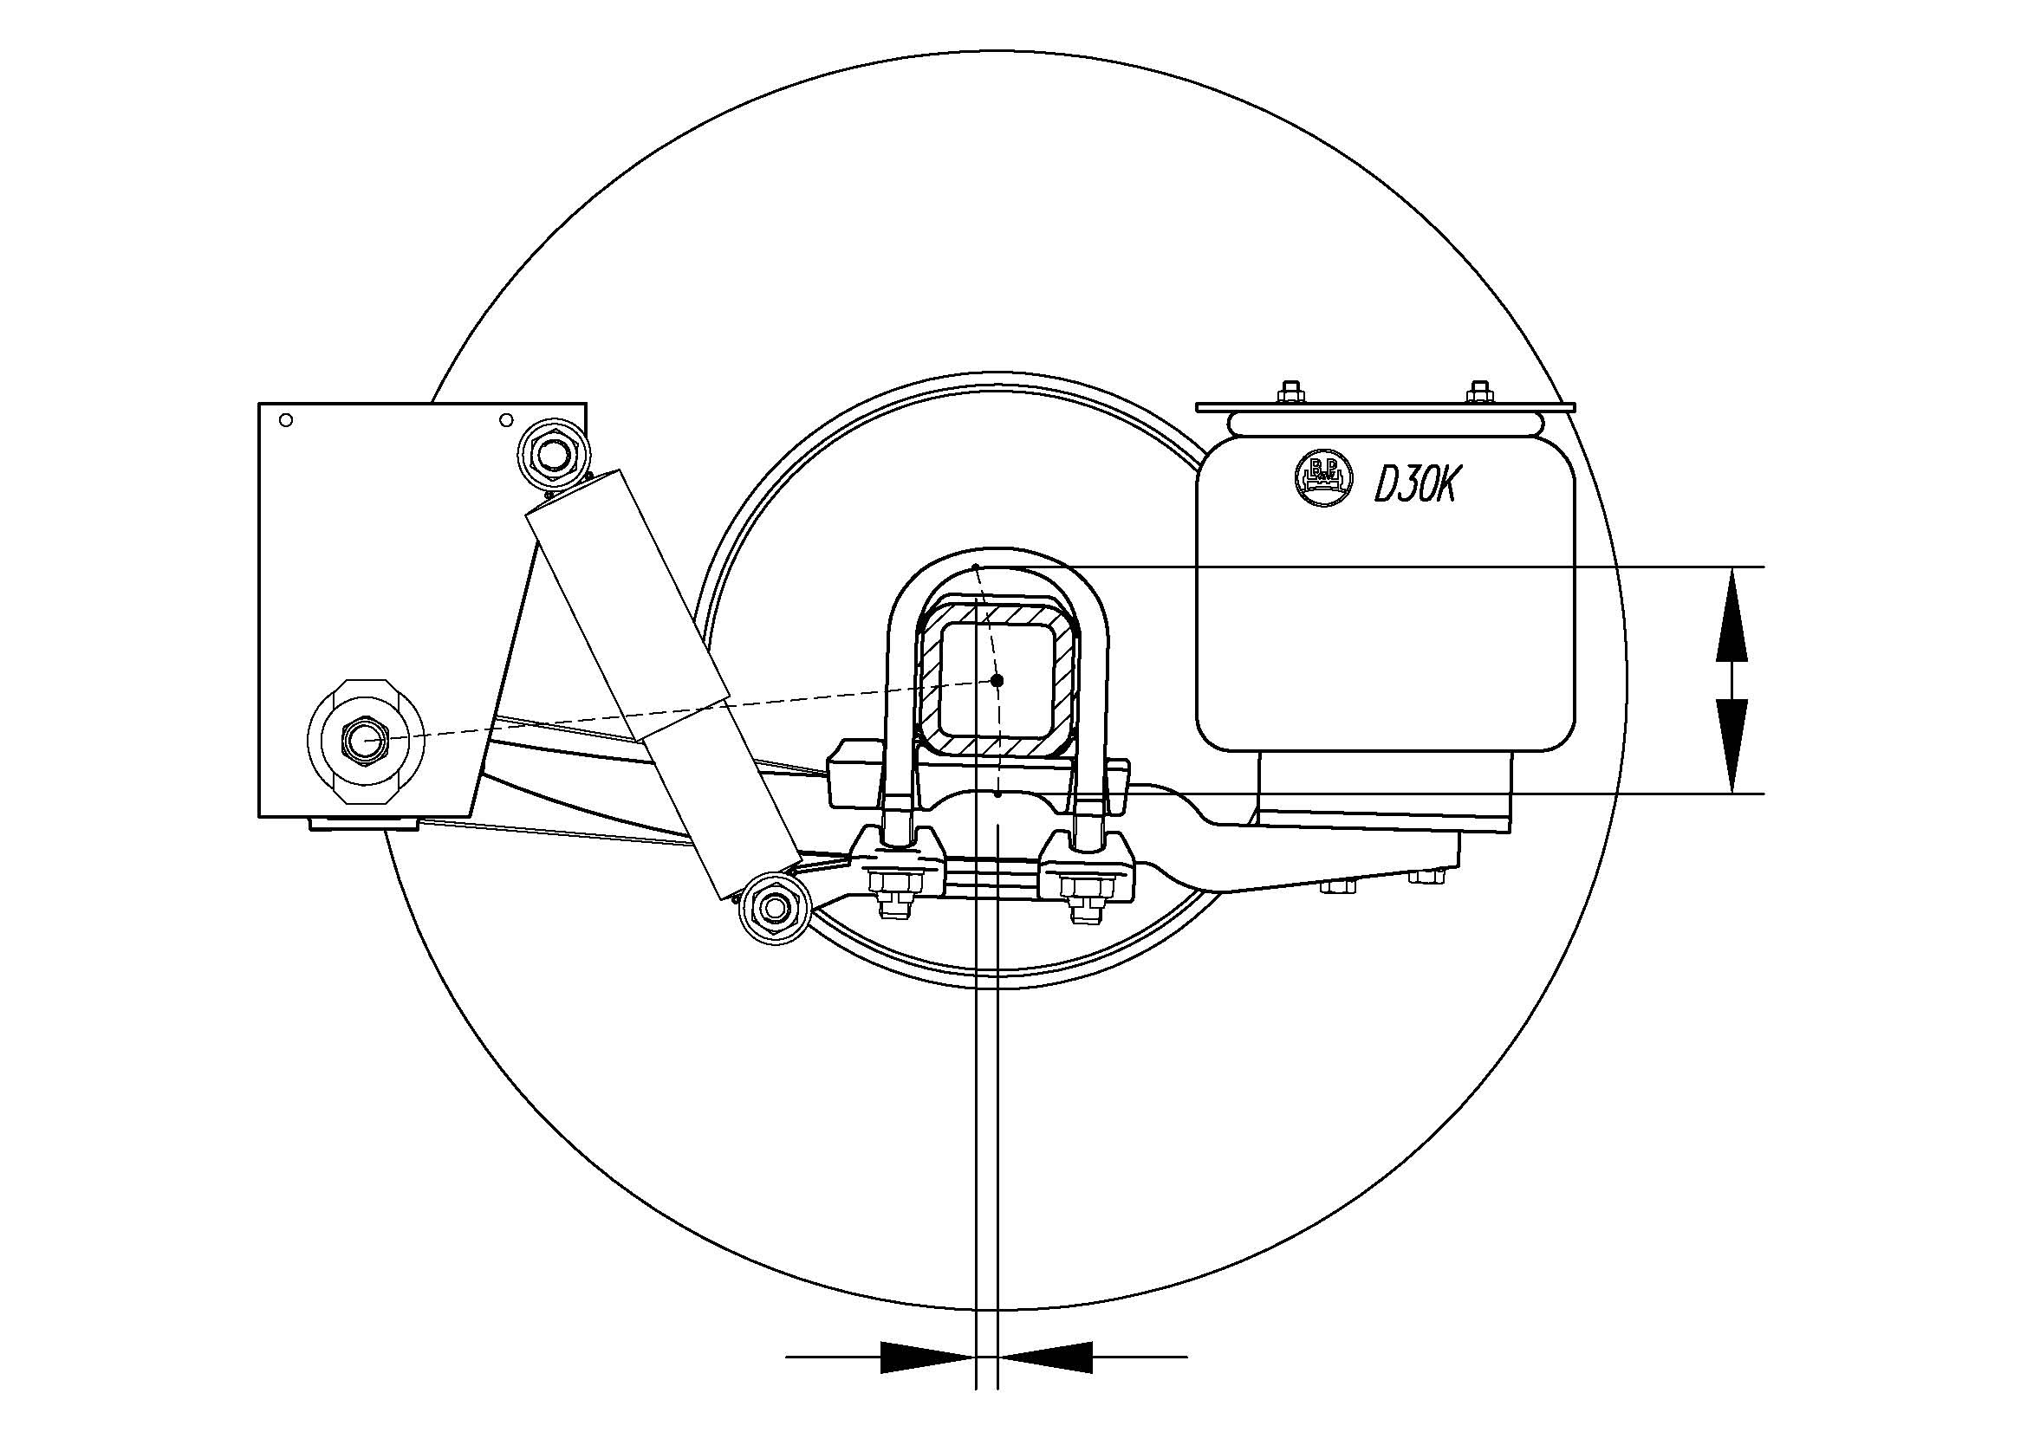
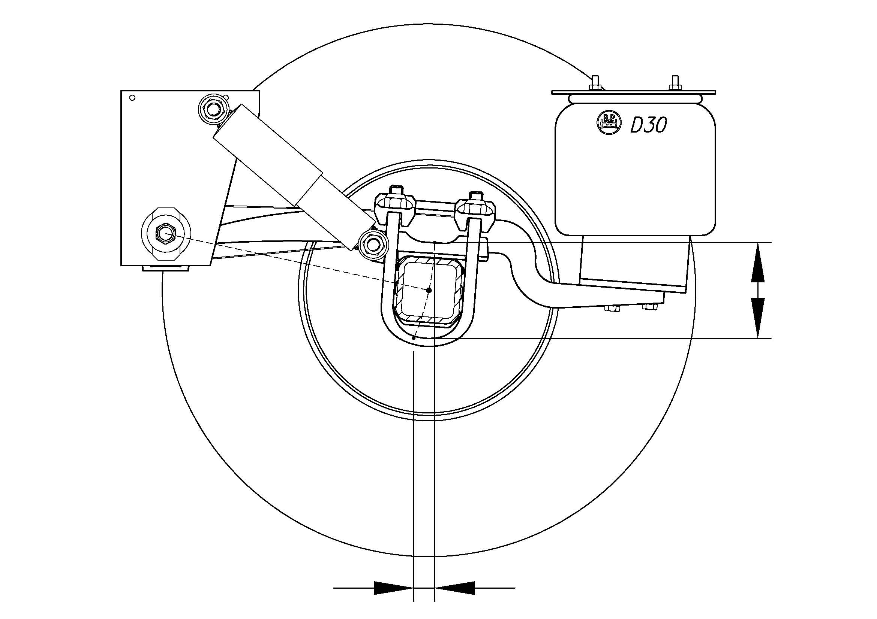
Roll Steer
The axle moves in an arc around the front pivots. It does not just move up and down, it moves backwards and forwards at the same time.
When the axle rolls about the roll centre, or tilts, one wheel moves up and the other down, so one wheel will move forward and the other backwards, effectively steering.

Slide 9
Roll Steer
Underslung Suspension
Overslung Suspension
Roll Steer depends on the length of the trailing arm, and the difference in height between the axle centre and the pivot point.
Underslung suspensions will generally steer into corners, overslung suspension will steer out of a corner.
The Roll Steer coefficient is a measure of the amount of steer relative to the roll on the suspension.

Slide 10
Airbag Suspension Parameters for PBS
Roll Stiffness
To improve, throttle crossflow between the airbags.
Roll Steer
Underslung suspensions better, and overslung suspensions with the axle height close to the pivot height
Roll Centre Height
Overslung suspensions better, suspensions with a larger distance between the axle and the pivot height will have a higher roll centre

Slide 11
