Slide 2

Review of Performance Based Standards for Level 3 and 4 vehicles
Marcus Coleman
PBS Conference – 6 March 2013

Slide 3

Context
Limited uptake of Level 3 and 4 vehicles
Alternative schemes facilitating safer and more productive vehicles
Desire for a nationally consistent framework
Notes:
Limited uptake of Level 3 and 4 vehicles because PBS offers little advantage compared with vehicles available under alternative schemes
Non PBS combinations have provided safety and productivity benefits and yet are unable to meet PBS requirements

Slide 4

Key Questions
What is limiting the uptake of Level 3 and 4 vehicles?
How can the standards be changed to encourage safer and more productive Level 3 and 4 vehicles?

Slide 5

Key Questions
How do we currently define safer and more productive?
Can we redefine safer?

Slide 6
Key Questions
Which standards are limiting the uptake of Level 3 and 4 vehicles?
  Infrastructure
  Powertrain
  Length and Width
  Low Speed Turning
  High Speed Stability

Slide 7
Infrastructure Standards
Pavement horizontal loading
Bridge

Slide 8
Powertrain
Performance Standard | Level 3 | Level 4
Startability | At least 10% | At least 5%
Gradeability (A) | At least 12% | At least 8%
Gradeability (B) | At least 70km/h | At least 60km/h
Acceleration Capability | 26 seconds | 29 seconds

Slide 9
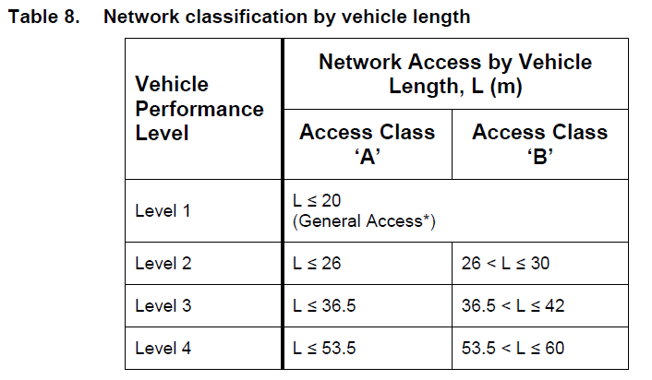
Length

Slide 10
Width

Slide 11
Low Speed Turning
Performance Standard | Level 3 | Level 4
Low Speed Swepth Path | 10.6m | 13.7m
Frontal Swing | 0.7m | 0.7m
MOD | 0.4m | 0.4m
DOM | 0.2m | 0.2m
Tail Swing | 0.35m | 0.50m
STFD | 80% | 80%

Slide 12
High Speed Stability
Performance Standard | Level 3 | Level 4
Static Rollover Threshold | 0.35g / 0.4g | 0.35g / 0.4g
Rearward Amplification | 5.7xSRT | 5.7xSRT
High Speed Transient Offtracking | 1.0m | 1.2m
Yaw Damping Coefficient | 0.15 | 0.15
Directional Stability Under Braking | 0.25g | 0.20g

Slide 13
Milestones
Stage 1: Discussion Paper (Apr ‘13)
Stage 2: Validation of assessment methods (May ‘13)
Stage 3: PBS Assessment of existing fleet (Sep ‘13)
Stage 4: Draft Report (Nov ‘13)
Stage 5: Final Report (Jan ‘14)

Slide 14
End

