Slide 1
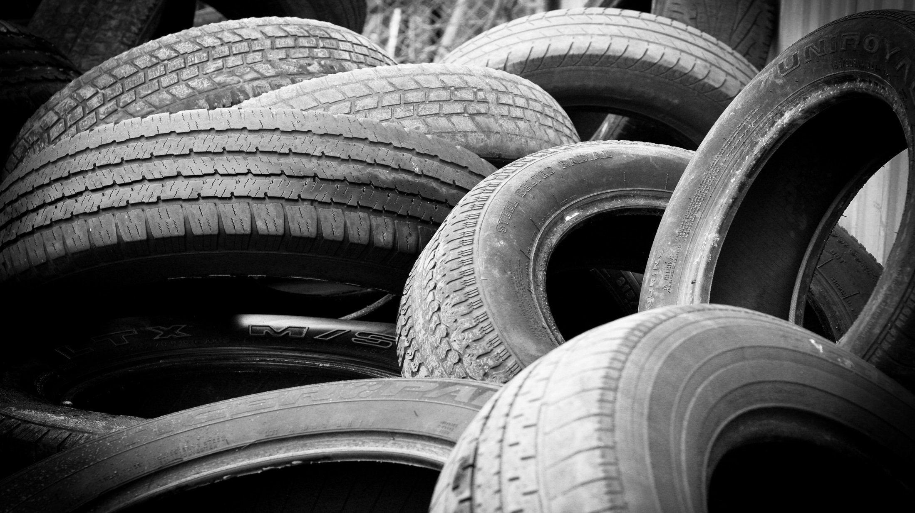

Reform Driven Innovation
Paul Retter AM
Chief Executive and Commissioner
National Transport Commission
Notes:
Good morning and thank you for the opportunity to speak to you today.
It is my view that we are facing the prospect of significant change in the transport and logistics sectors over the next 10 years. These changes will affect both the heavy vehicle sector and the way in which governments regulate the industry.
Both industry the governments need to better understand the major drivers of change likely to emerge over the next decade so that we can both accommodate, respond to and shape these changes where appropriate.

Slide 2

Global trends
Transport trends
Challenges for governments
Notes:
You all know that the transport and logistics sectors are complex and are constantly evolving.
The impact of new technologies underpinned by better access to data and near real-time analytics is acting as a powerful catalyst for change across the globe affecting today’s market structures and the demand for products and services across the transport and logistics sectors.
More automated transport systems, increases in ‘on-demand’ and shared mobility solutions, and consumers desire for greater convenience are all factors likely to affect the provision of transport services across the globe, particularly in our larger cities and urban areas over the next decade.
Governments also have a role in driving change where markets either fail to act or do not respond quickly enough to emerging community challenges.
In recent years governments around the globe have sought to encourage safer, more sustainable and environmentally friendly transport systems.
Overseas examples of this include:
Establishment of congestion zones and low/ultra low emissions zones in London.
Scandinavian countries are encouraging the increased use of hybrid or electric powered vehicles through a range of incentives including reduced registration charges and in some cases waiving all registration charges.
Japan has regulatory arrangements in place that restrict the registration of vehicles when they reach a certain age.
There are also ongoing efforts around the globe to reform the way we will pay for access to key public road networks.
In Australia, safety and productivity concerns are acting as powerful drivers for government action. The pressure on governments to respond to increased fatalities and serious injuries as a result of vehicle crashes is increasing.
The domestic freight task is increasing – NTC believes it will grow by 27% over the next 10 years – and pressure on governments to facilitate and better manage freight movements is likely to see governments consider a range of initiatives as part of the National Freight & Supply Chain Strategy currently under development.
In times of rapid technology-led change, one of the additional challenges for governments is to ensure that new transport-related products and services are safe and that their operational deployment is in the community’s interest, whilst at the same time ensuring that current laws do not act as barriers to innovation that will deliver potential safety and productivity benefits – this requires law makers to carefully balance these, sometimes competing, requirements.

Slide 3

Drivers of change
Increased levels of automation
Digital marketplaces for freight
Blockchain
Last mile delivery options
(aerial drones and 3D mobility corridors)
Notes:
Over the next 10 years we expect significant change to occur across the transport and logistics sectors in Australia. On this slide are just a few examples of technology and data driven changes we are starting to see emerge overseas and in Australia.
Automation and smart infrastructure have the potential to transform freight movements. We have seen the discrete application of autonomous trucks and trains at Rio Tinto’s mines in the Pilbara, however the use of ‘more-automated’ trains and road vehicles carrying freight will increase over the next 10–15 years.
Digital marketplaces, also known as online marketplaces or platform companies, are redefining business in every industry, including transport and logistics. Digital transport markets are characterised by sharing information that was, to some extent, previously held as ‘commercial in confidence’, giving companies a competitive edge.
There are now more devices than people connected to the internet. In the last few years we have seen an explosion of apps to replace or build on these platforms and utilise the increasing amount of data available and these connected devices.
The next evolution might be Blockchain, or similar secure, private ledgers and e-contracts between parties. In May 2017, Deloitte tweeted that 10% of global GDP would be built on top of Blockchain applications. Blockchain has the potential to cut out some incumbent intermediaries in the existing logistics and supply chain. For example, peer-to-peer ridesharing that cuts out the ‘booking platform’ such as Uber. This raises some interesting questions for government on how we regulate the parties involved.
We are also seeing trials of aerial drones, land-based robots and vehicles that can operate across multiple environments – these new freight delivery technologies may alter the way we achieve last mile deliveries, particularly in our big cities and they certainly pose some interesting regulatory challenges for governments as we move towards 3-dimensional mobility corridor solutions to move people and goods more efficiently.

Slide 4

Potential benefits of tech/data led change
Better safety outcomes
Improved access and mobility options
Reduced congestion in our major cities
Improved efficiency/productivity along key supply chains
Better planning and decision making for industry and government
Notes:
The potential benefits of these types of changes are the subject of almost daily discussion in the media.
While we can debate likely implementation dates and market impacts, it is likely that—collectively—they will deliver varying degrees of benefit summarised on this slide.

Slide 5

Future heavy vehicle technology
Likely changes:
Increased levels of automation and connectivity
Increased access to data and near real time analytics related to vehicle and driver performance
Enhancements to stability control, braking systems, collision avoidance systems
Cleaner and more efficient propulsion systems
Better performing PBS vehicles
Notes:
From a heavy vehicle perspective the demand for safer, more productive and environmentally friendly vehicles has and will continue to drive innovation in Australia’s heavy vehicle sector.
Australia has, in many ways, led the way in terms of global heavy vehicle innovation and the various heavy vehicle combinations we see moving freight in Australia today is testimony to the industry’s ability to invest in and utilise innovative vehicles to address some of the unique freight and environmental challenges we face in Australia.
In response to increases in the freight task and more strident community expectations I also suspect governments will be increasingly keen to ensure safer, more productive and environmentally friendly vehicles are operating on our key freight routes. Technologies that increase the safety performance of a vehicle, reduce emissions and vehicle designs that allow more productive and safer vehicles on our roads should be encouraged wherever possible.
Looking ahead I would suggest the types of changes in technology we are likely to see in heavy vehicle design and capability over the next decade will reflect:
progressive improvements in vehicle automation technology
greater access to data and near real-time analytics for operators and drivers
enhancements to existing vehicles as a result of retrofitting better rollover stability control technology, emergency braking systems, increasing use of telematics devices including in-cabin driver performance monitoring systems, better lane-keeping technology and more efficient and cleaner propulsion systems.
new vehicles and trailers entering the market incorporating many of these technology features as “standard”.
In Australia, the Performance Based Standards Scheme has been in operation since 2007 and provides an example of what can be done to encourage industry to pursue vehicles that offer improved heavy vehicle safety and productivity performance. NTC has just completed a review of the PBS scheme and will propose some significant recommendations to Ministers in May this year that are designed to further improve the scheme’s performance and increase PBS vehicle take up across the industry.

Slide 6


Regulation in an era of rapid change
Responsive and flexible
Less prescription
Performance-based
Notes:
In my view, rapid technology and data-driven changes pose a number of significant legislative challenges. These changes are likely to require governments to carefully re-examine the way they regulate to ensure transport and logistics systems remain both safe and sustainable.
This is not an easy task… however, the risk governments face by not being proactive is that in times of rapid change, existing regulations will quickly become less ‘fit for purpose’ and in fact delay, or act as barriers to, the introduction of innovative business models that have the potential to deliver productivity and safety benefits to our communities.
The laws governing heavy vehicles in Australia can be improved. They are, in my view, overly prescriptive in nature and are unable to easily accommodate rapid technology change. It is my view that we need to move to more performance-based laws that are technology-neutral and principles based. These types of laws, if implemented, will be more flexible and responsive to change.
Governments also need to consider the best ways to encourage increased industry take up of technology that will improve heavy vehicle safety, productivity and environmental outcomes, whether this is through retro-fitting technology into existing heavy vehicles or encouraging operators to the purchase newer vehicles with many of the technologies already embedded with the vehicle’s design.

Slide 7
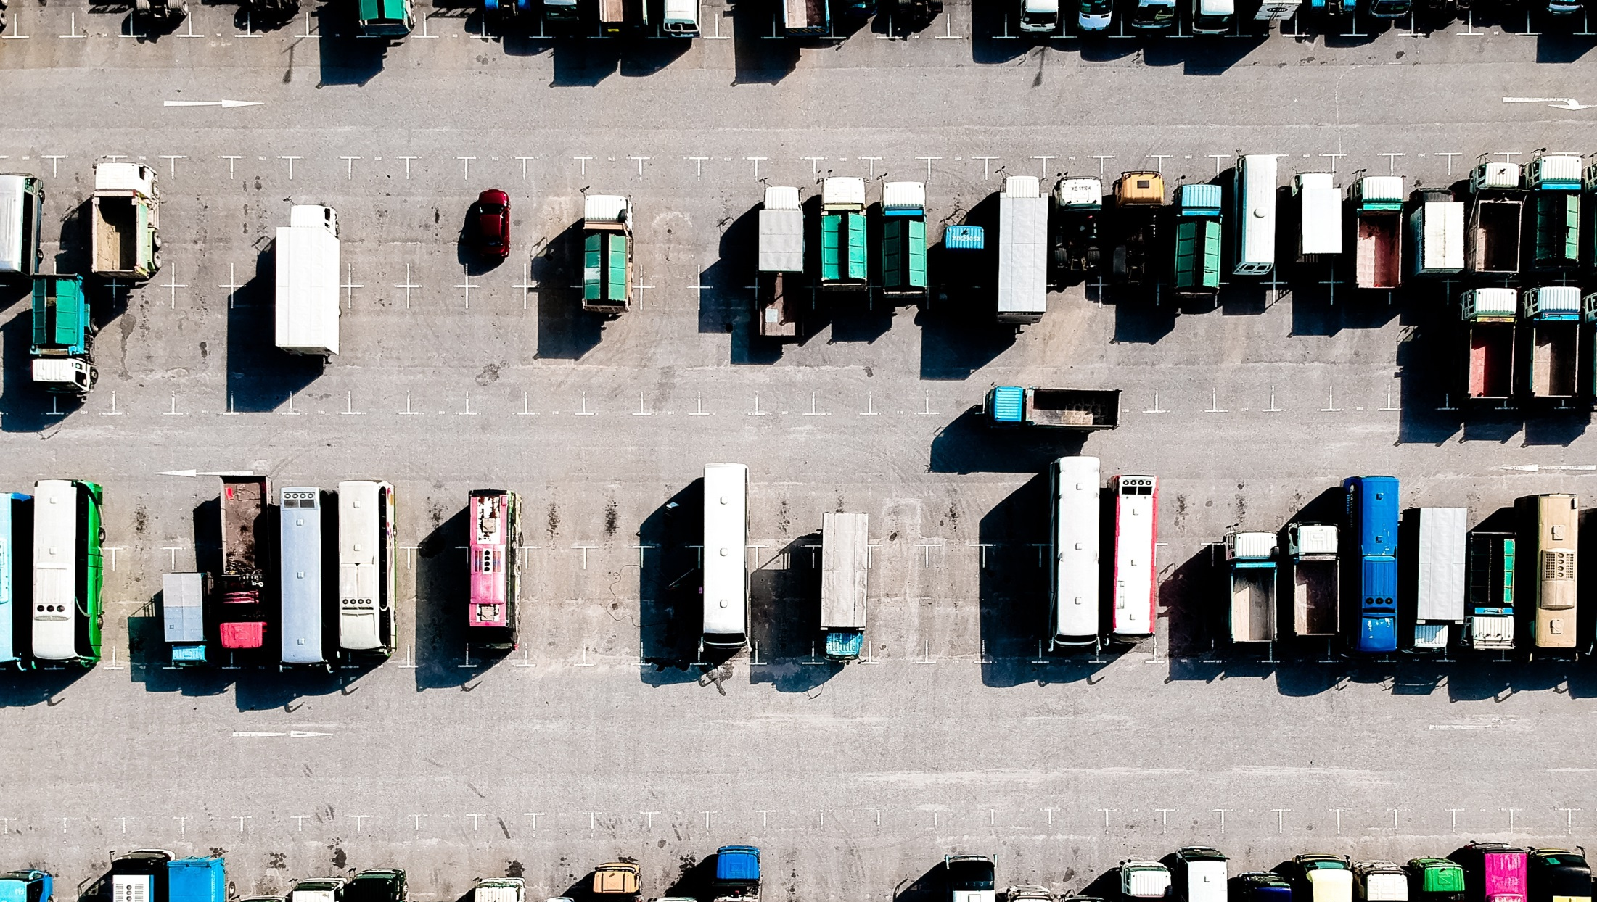


Thank you
www.ntc.gov.au
@NTC_AUS
National Transport Commission
Notes:
I look forward to discussing these issues in more detail as part of the panel session.

